Slide 1
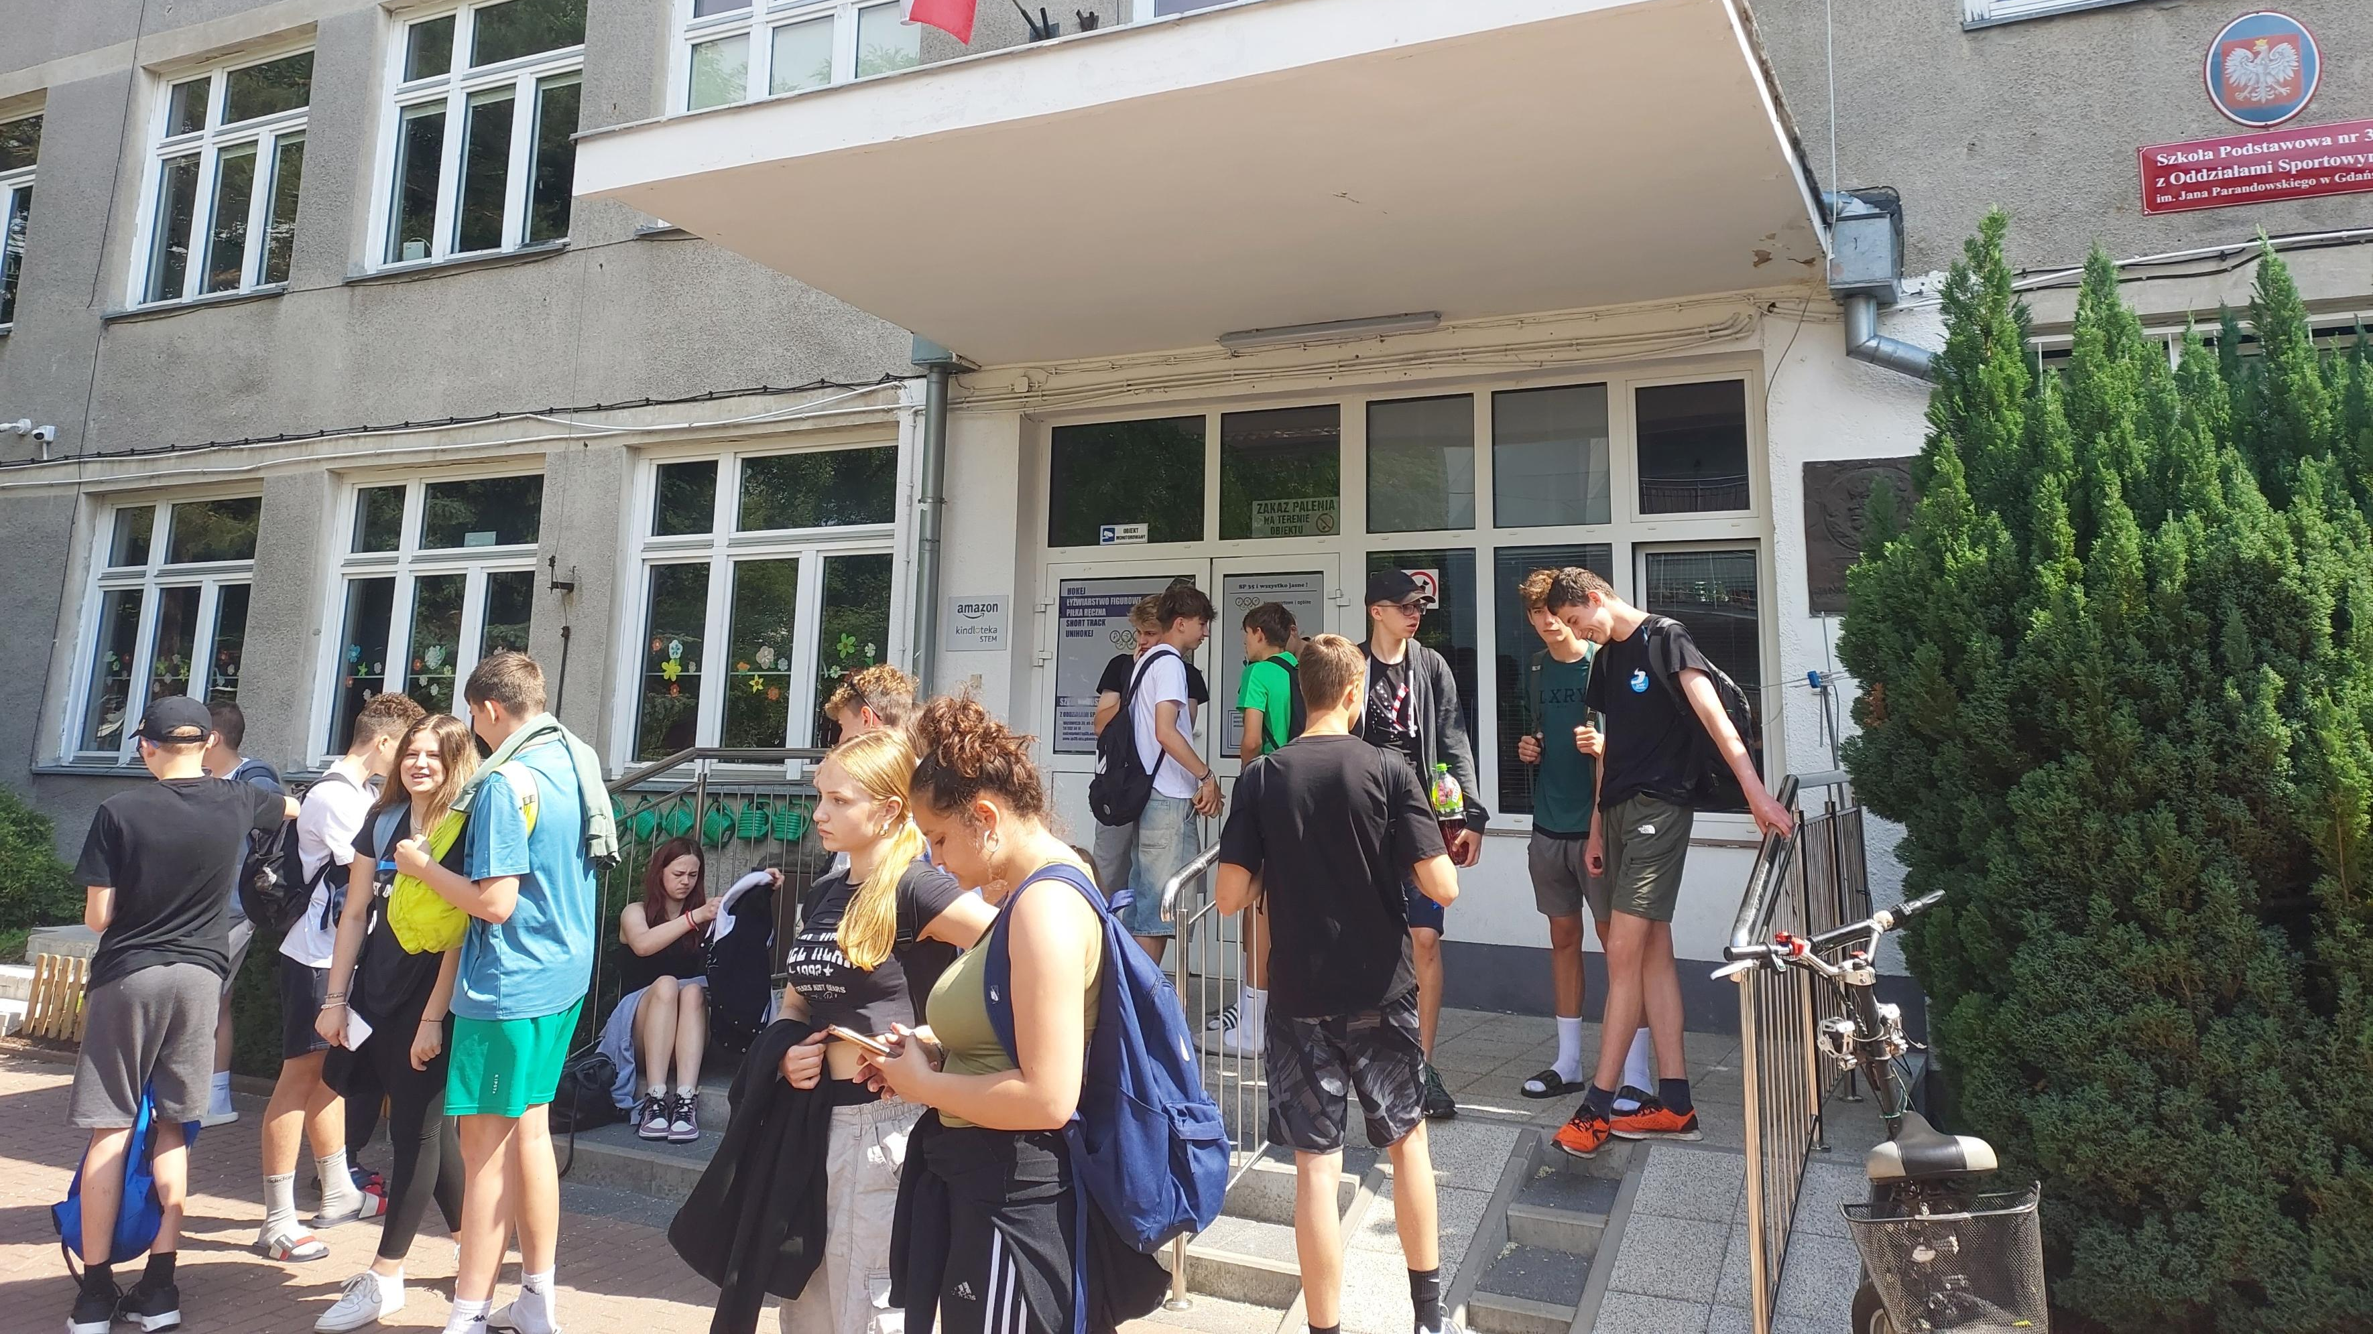
Last day in Poland
Sehnalová, Kakovkina, Klemešová

Slide 2
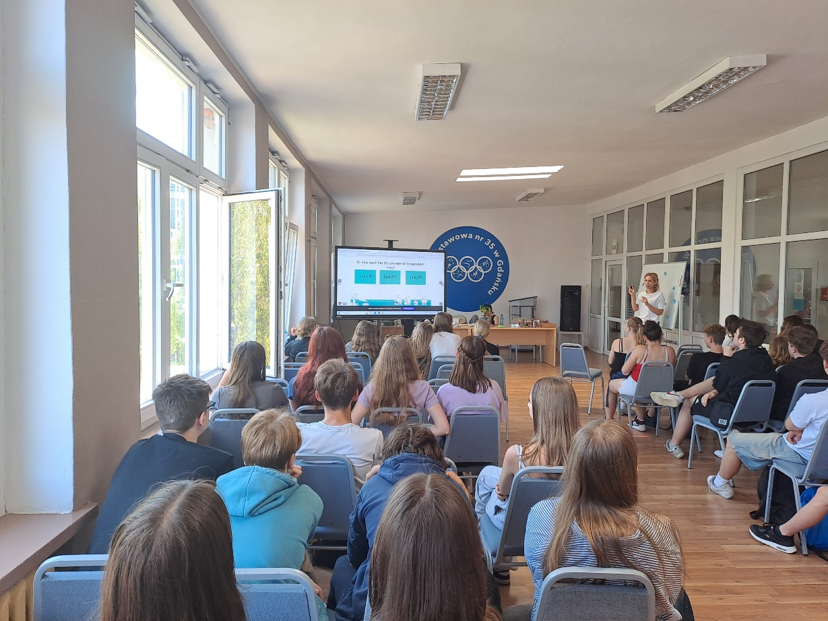
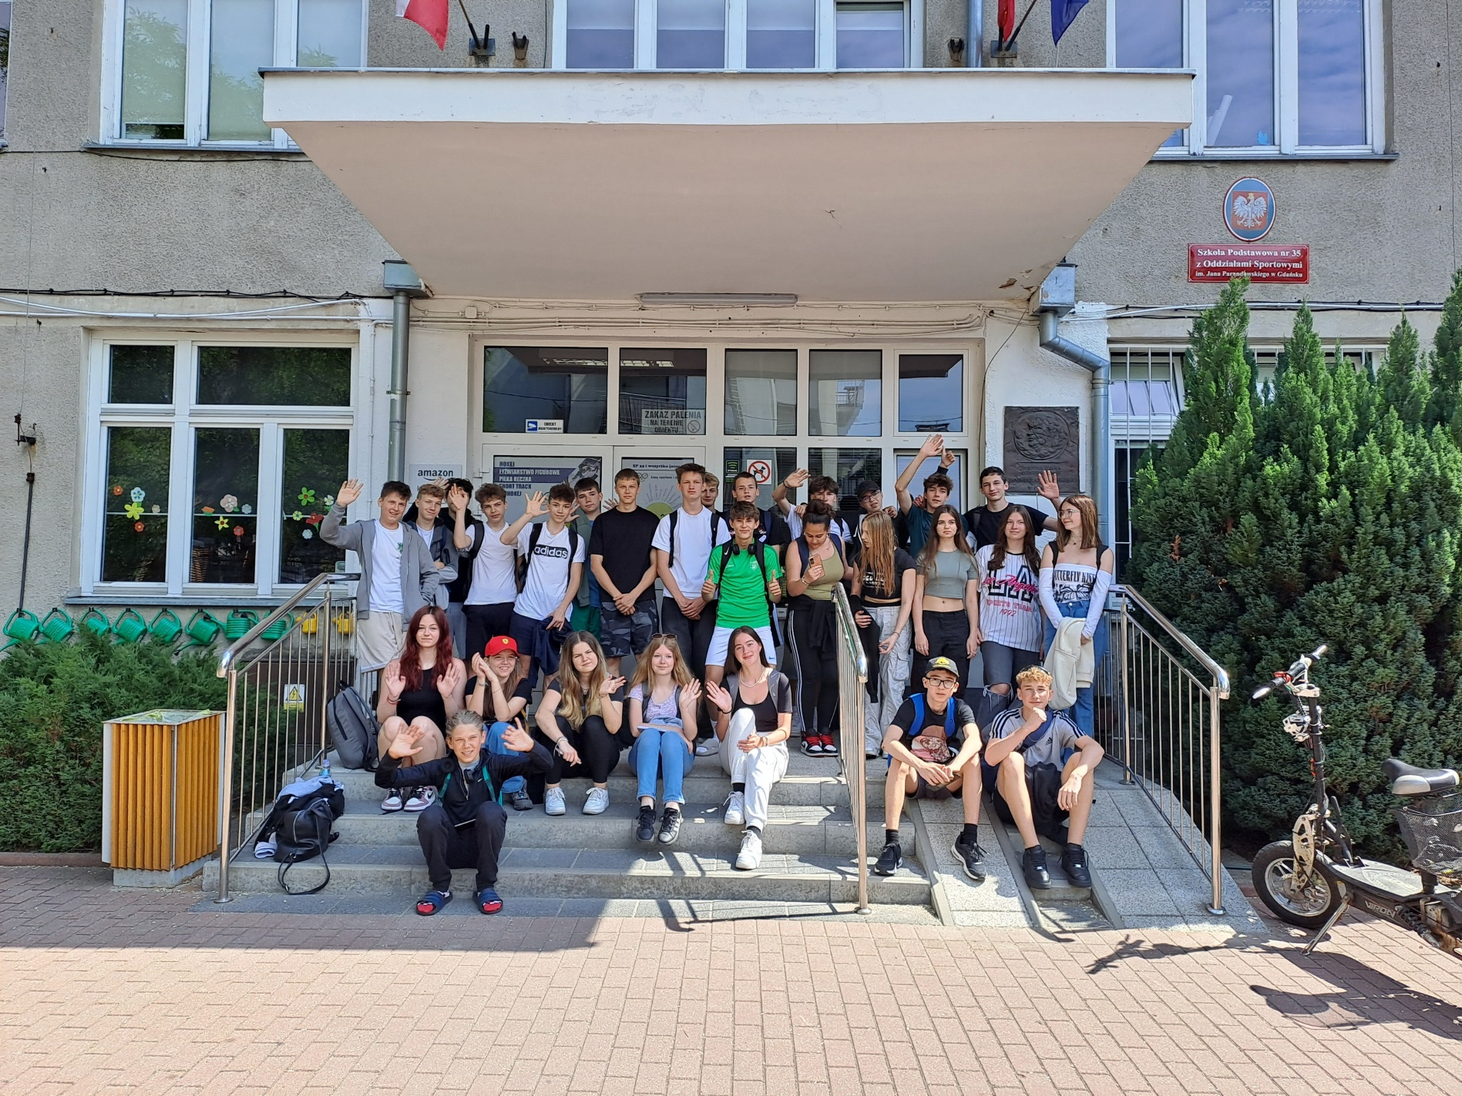
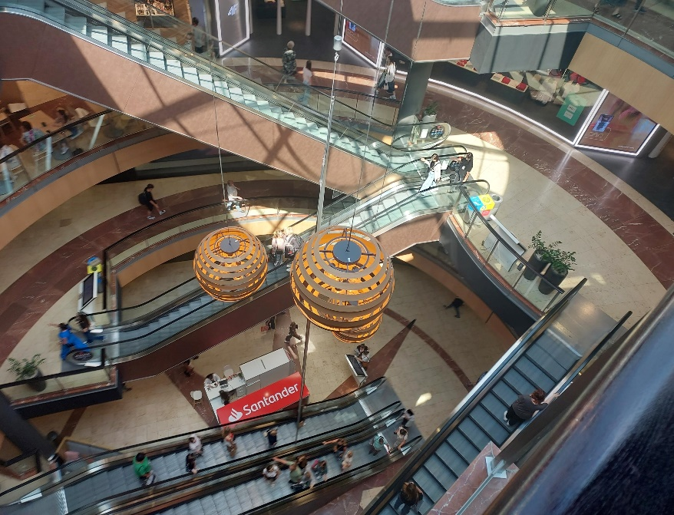
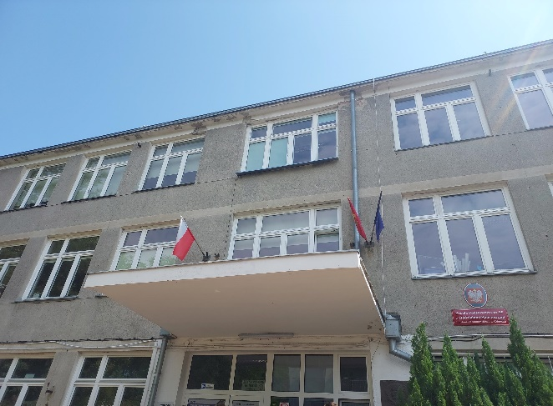
We started our day with breakfast and then after it we went to say goodbye to our friendly school. Then we waited for our last lunch and went to the mall. There was pretty much fun and then we went back to the Czech Republic. This trip was amazing and we are grateful for this wonderful experience.

