Slide 1
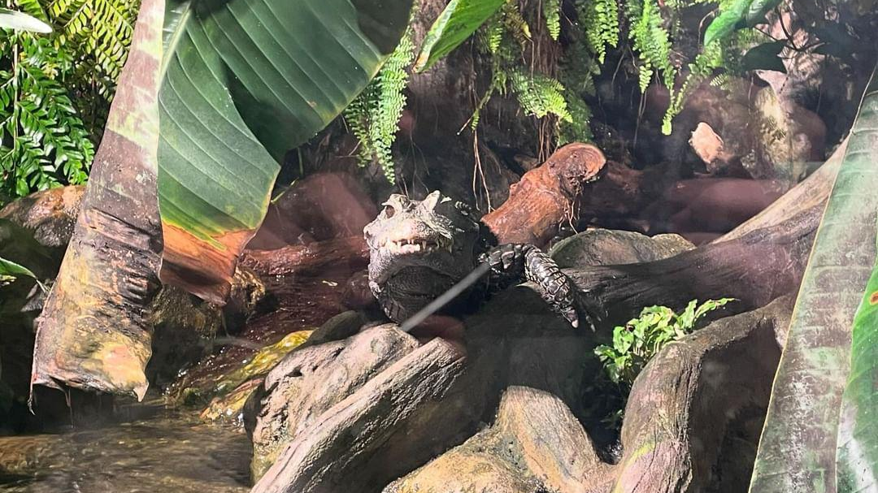
Day 4
Rieger, Navrkal, Macek,Kopecký

Slide 2
Day 4
The day strarted normally. We had breakfast and at 10:15 then we headed straight to the aquarium. We saw a lot of cool new kinds of fish and a lot of things we haven´t seen before. Then we had a longer break and free time to explore the main street with many shops and restaurants. After that we visited a museum called „Muzeum marynarki wojennej“ and a military cruiser. In the evening we returned to our hotel. After dinner we went to Lidl and McDonalds. Around 11:30 pm we went to bed. It was very fun day.

Slide 3
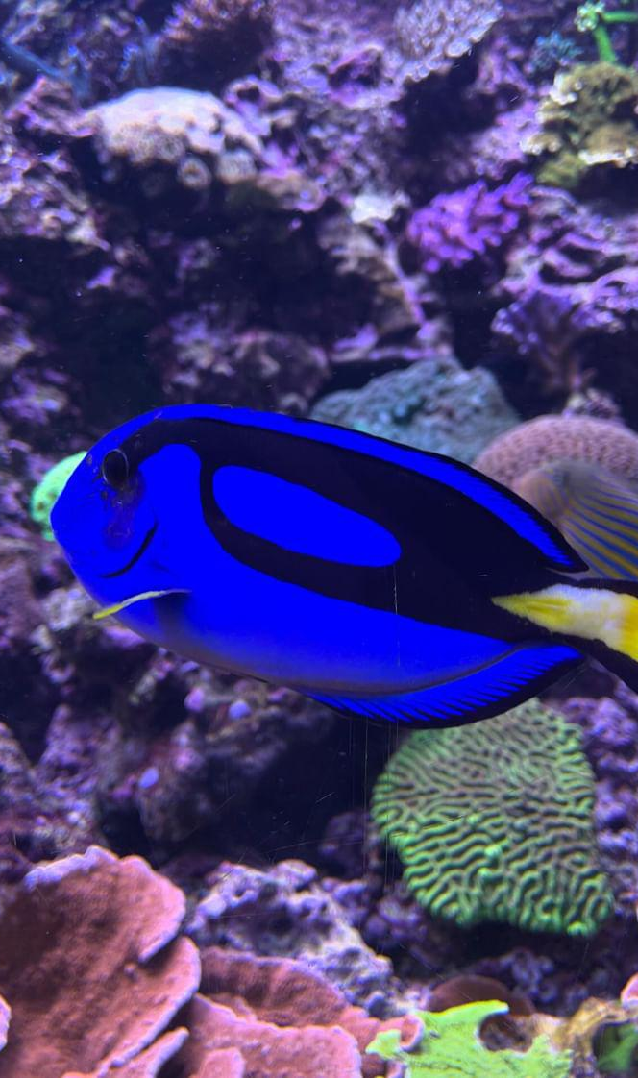

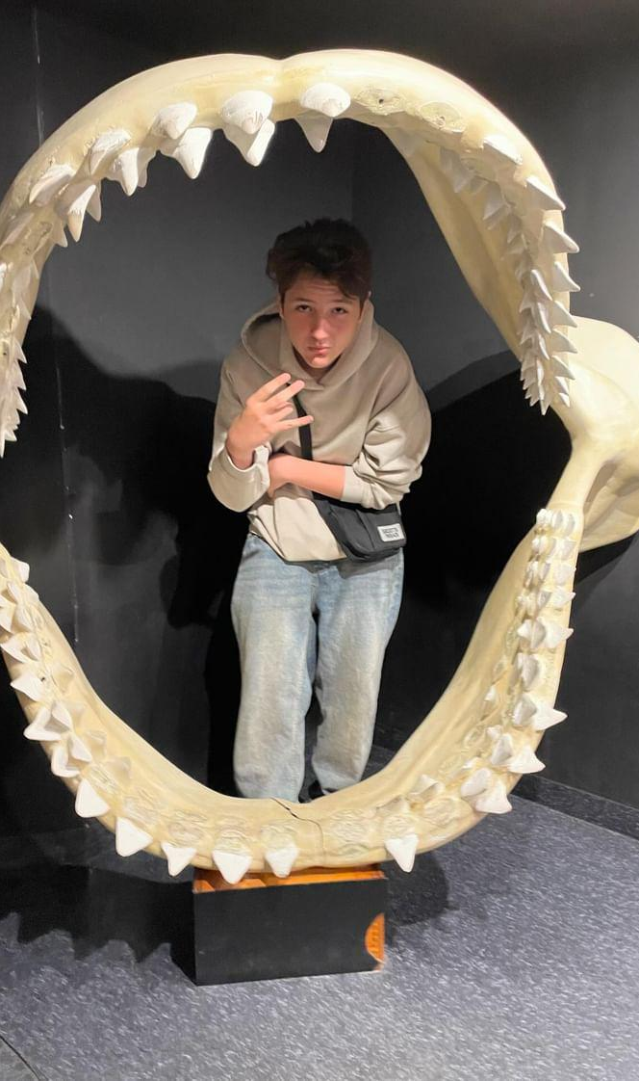
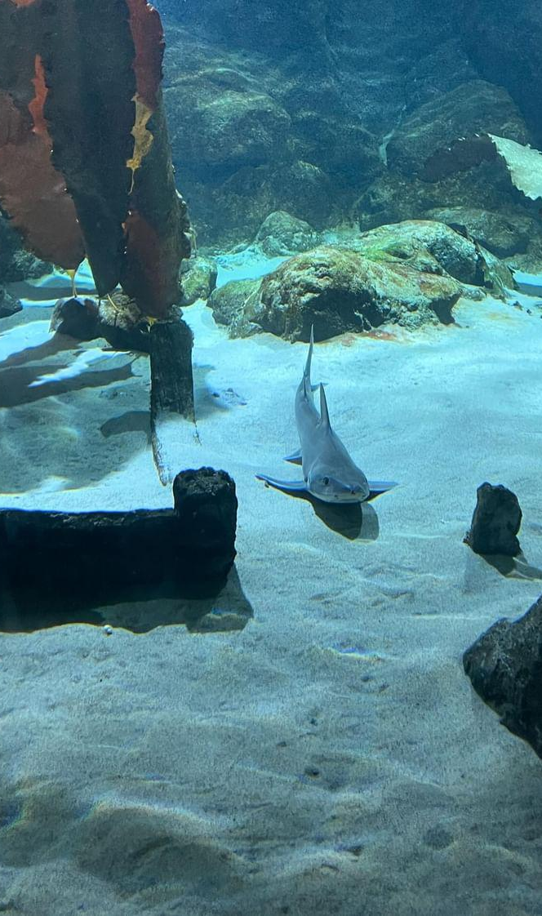
Aquarium

Slide 4
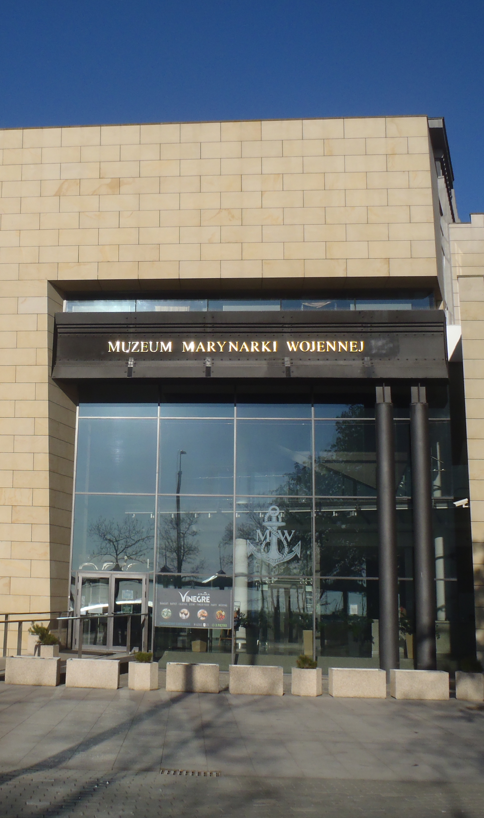
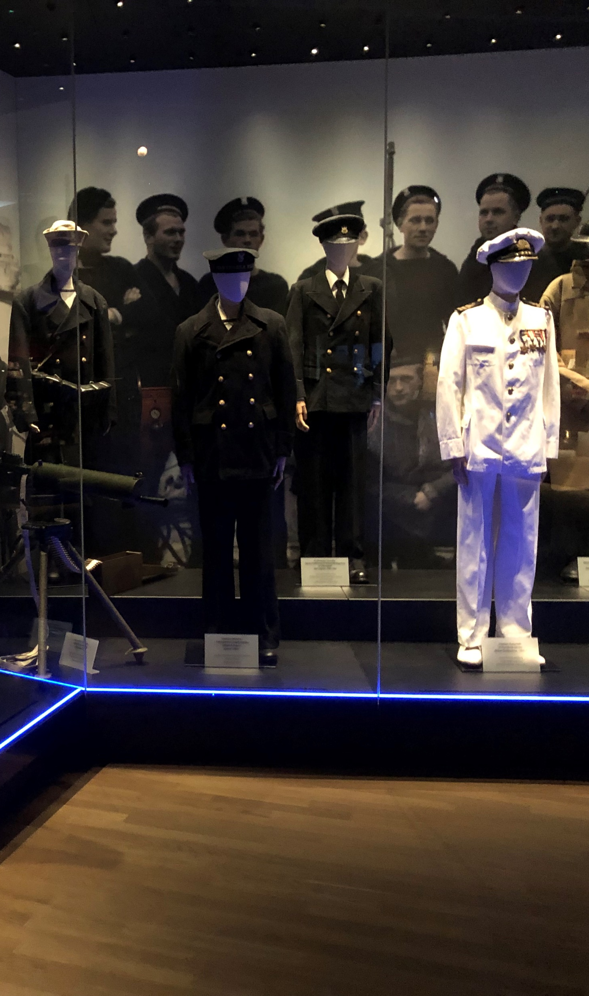
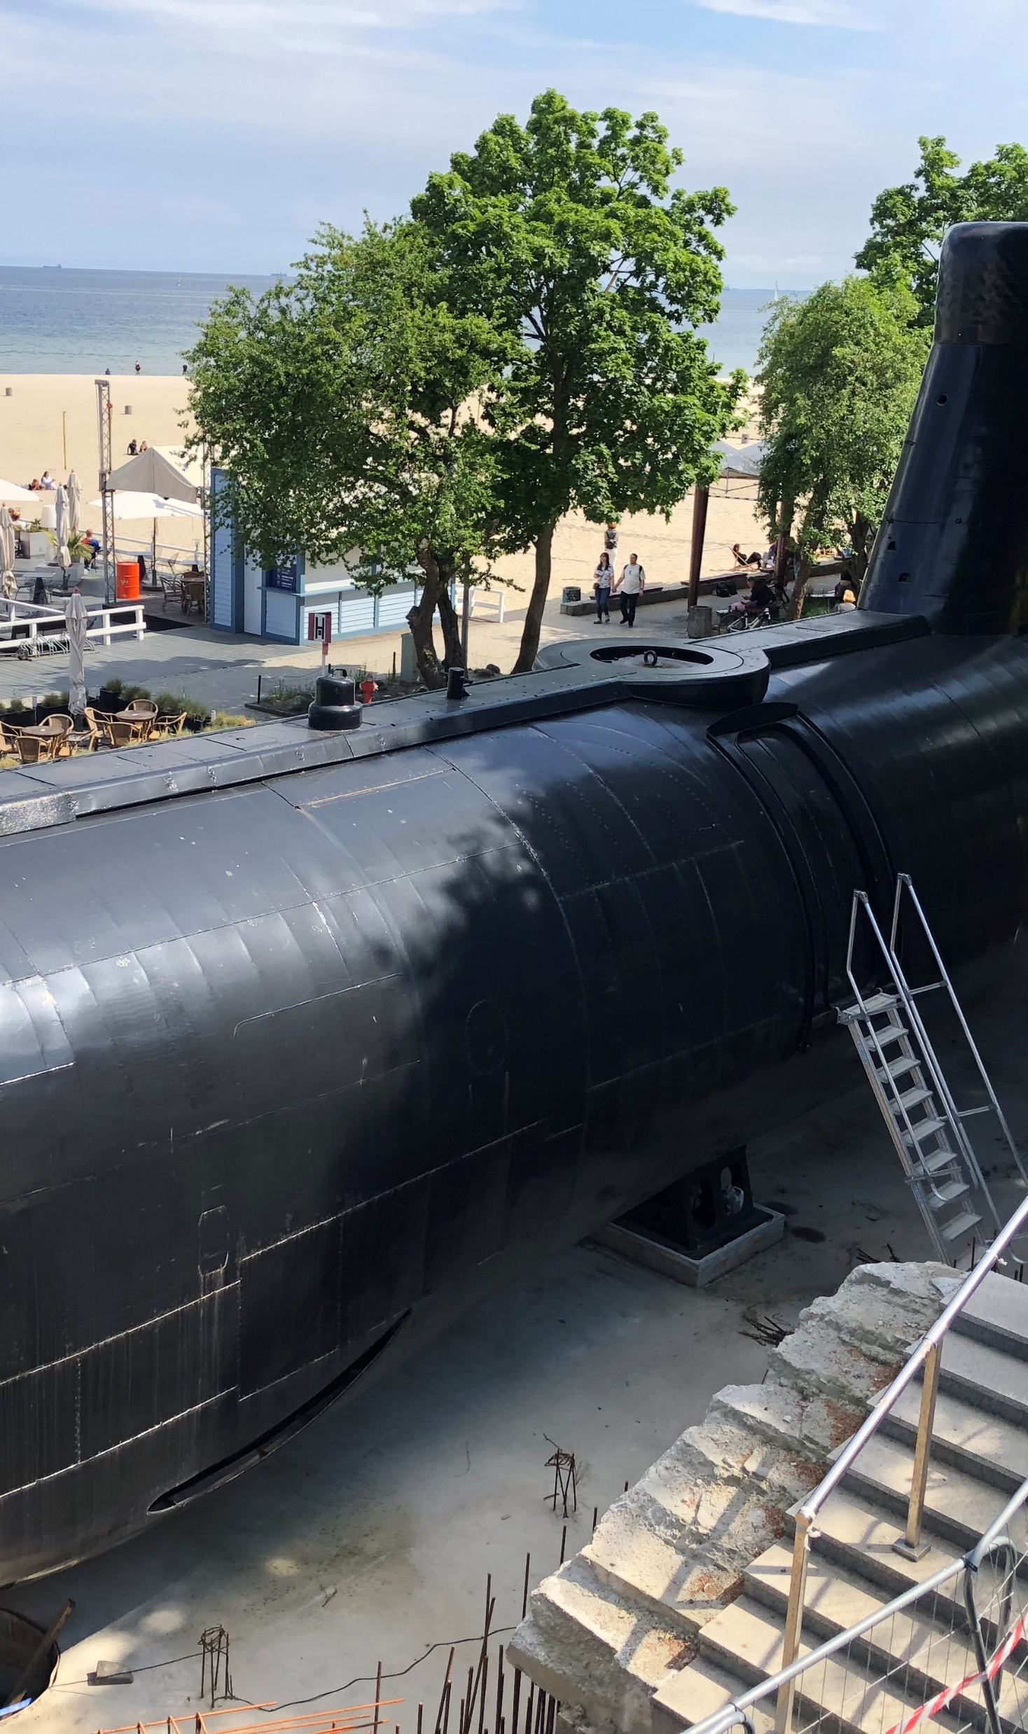
Muzeum Marynarki Wojennej

