Slide 1
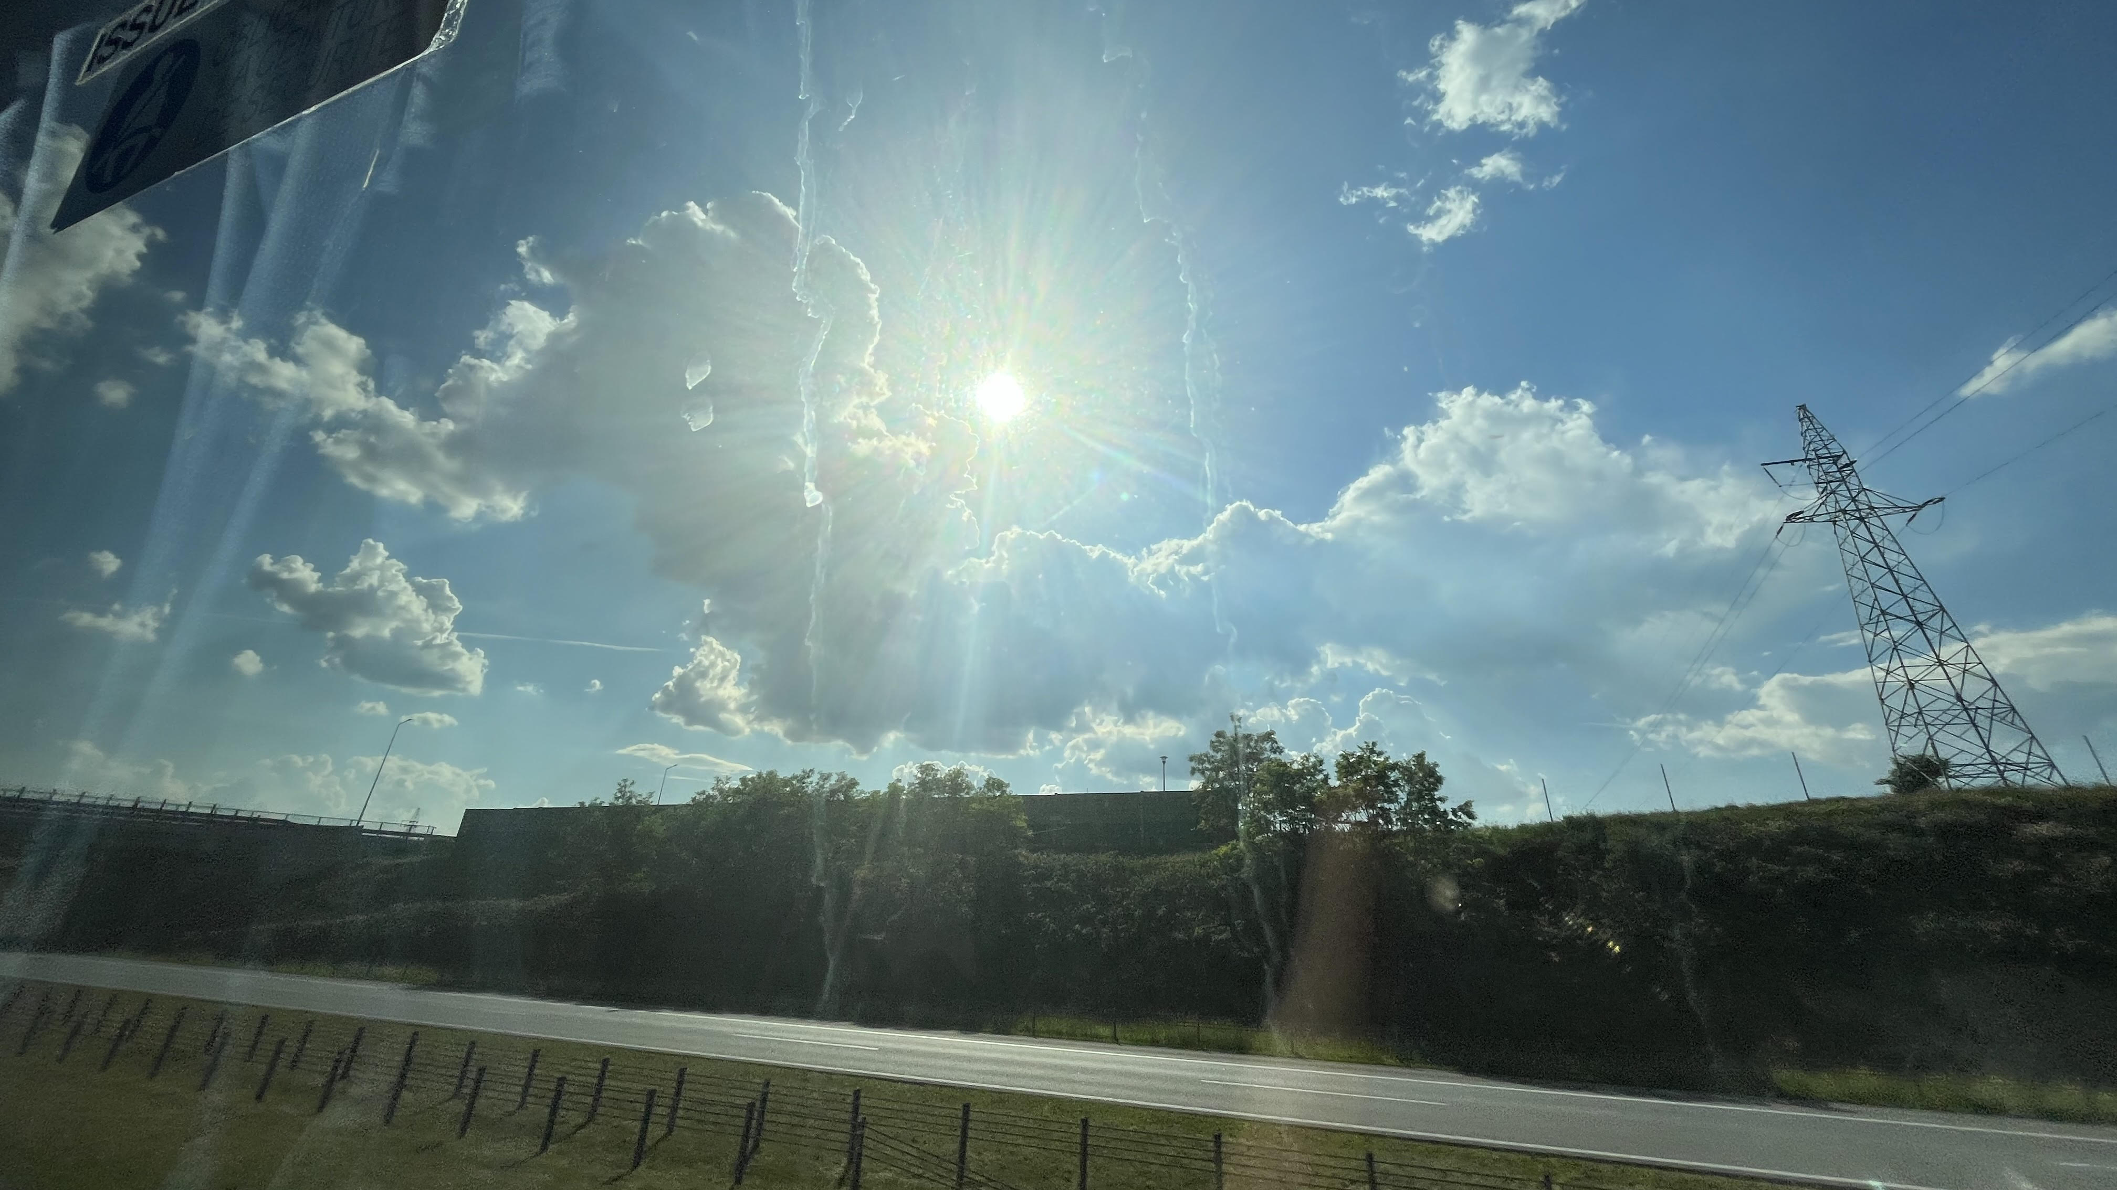
Day 1 arrival
Zelinka, Kroužel, Horáček

Slide 2
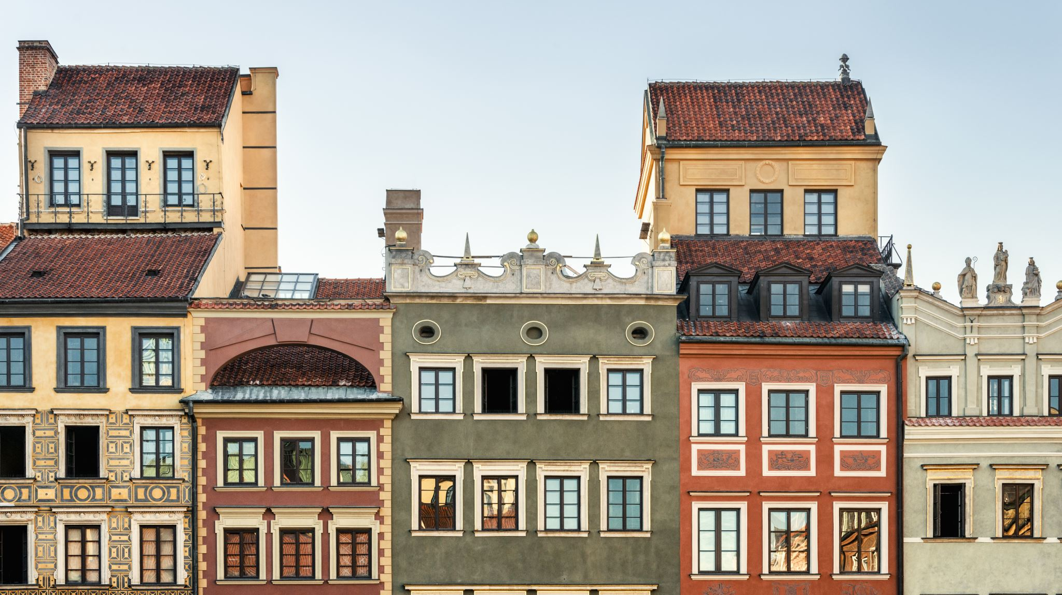
Our trip to Poland - Gdansk
On Sunday, we left the Czech Republic at 11 am and we went to Poland.
We were really looking forward to it. The beginning of the trip was a bit boring. But then we started playing poker with friends and teachers read books and chatted. After three hours we had our first stop for the snacks. The time passed quickly, because we were really having fun. After arriving in Poland we checked in and quickly ran to watch the hockey world championship, because the Czech team played the final with Switzerland. We were very happy about the victory of the Czech Republic. After hockey we had a shower and slowly went to sleep.

Slide 3
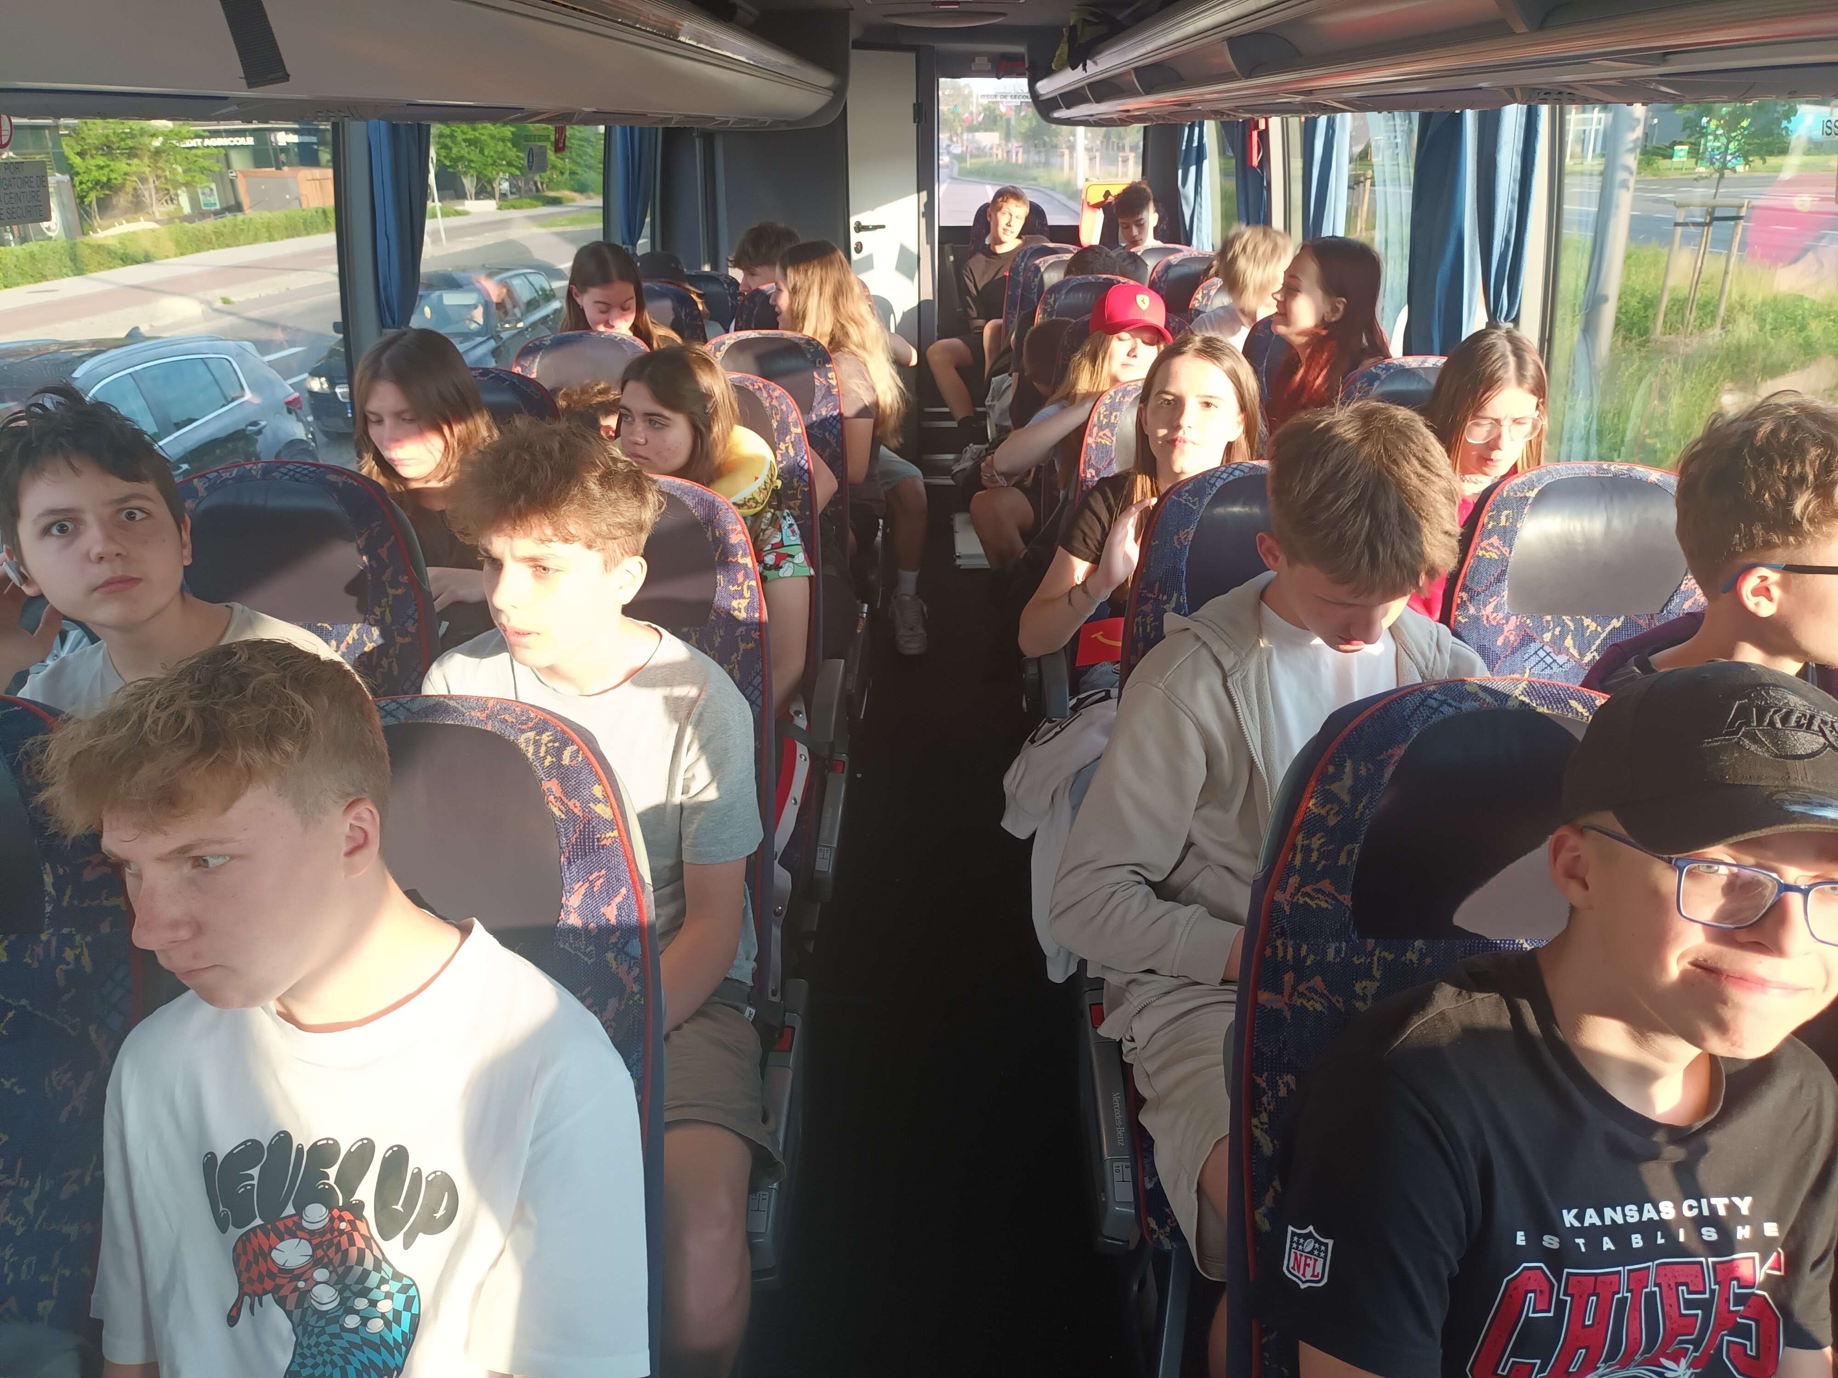
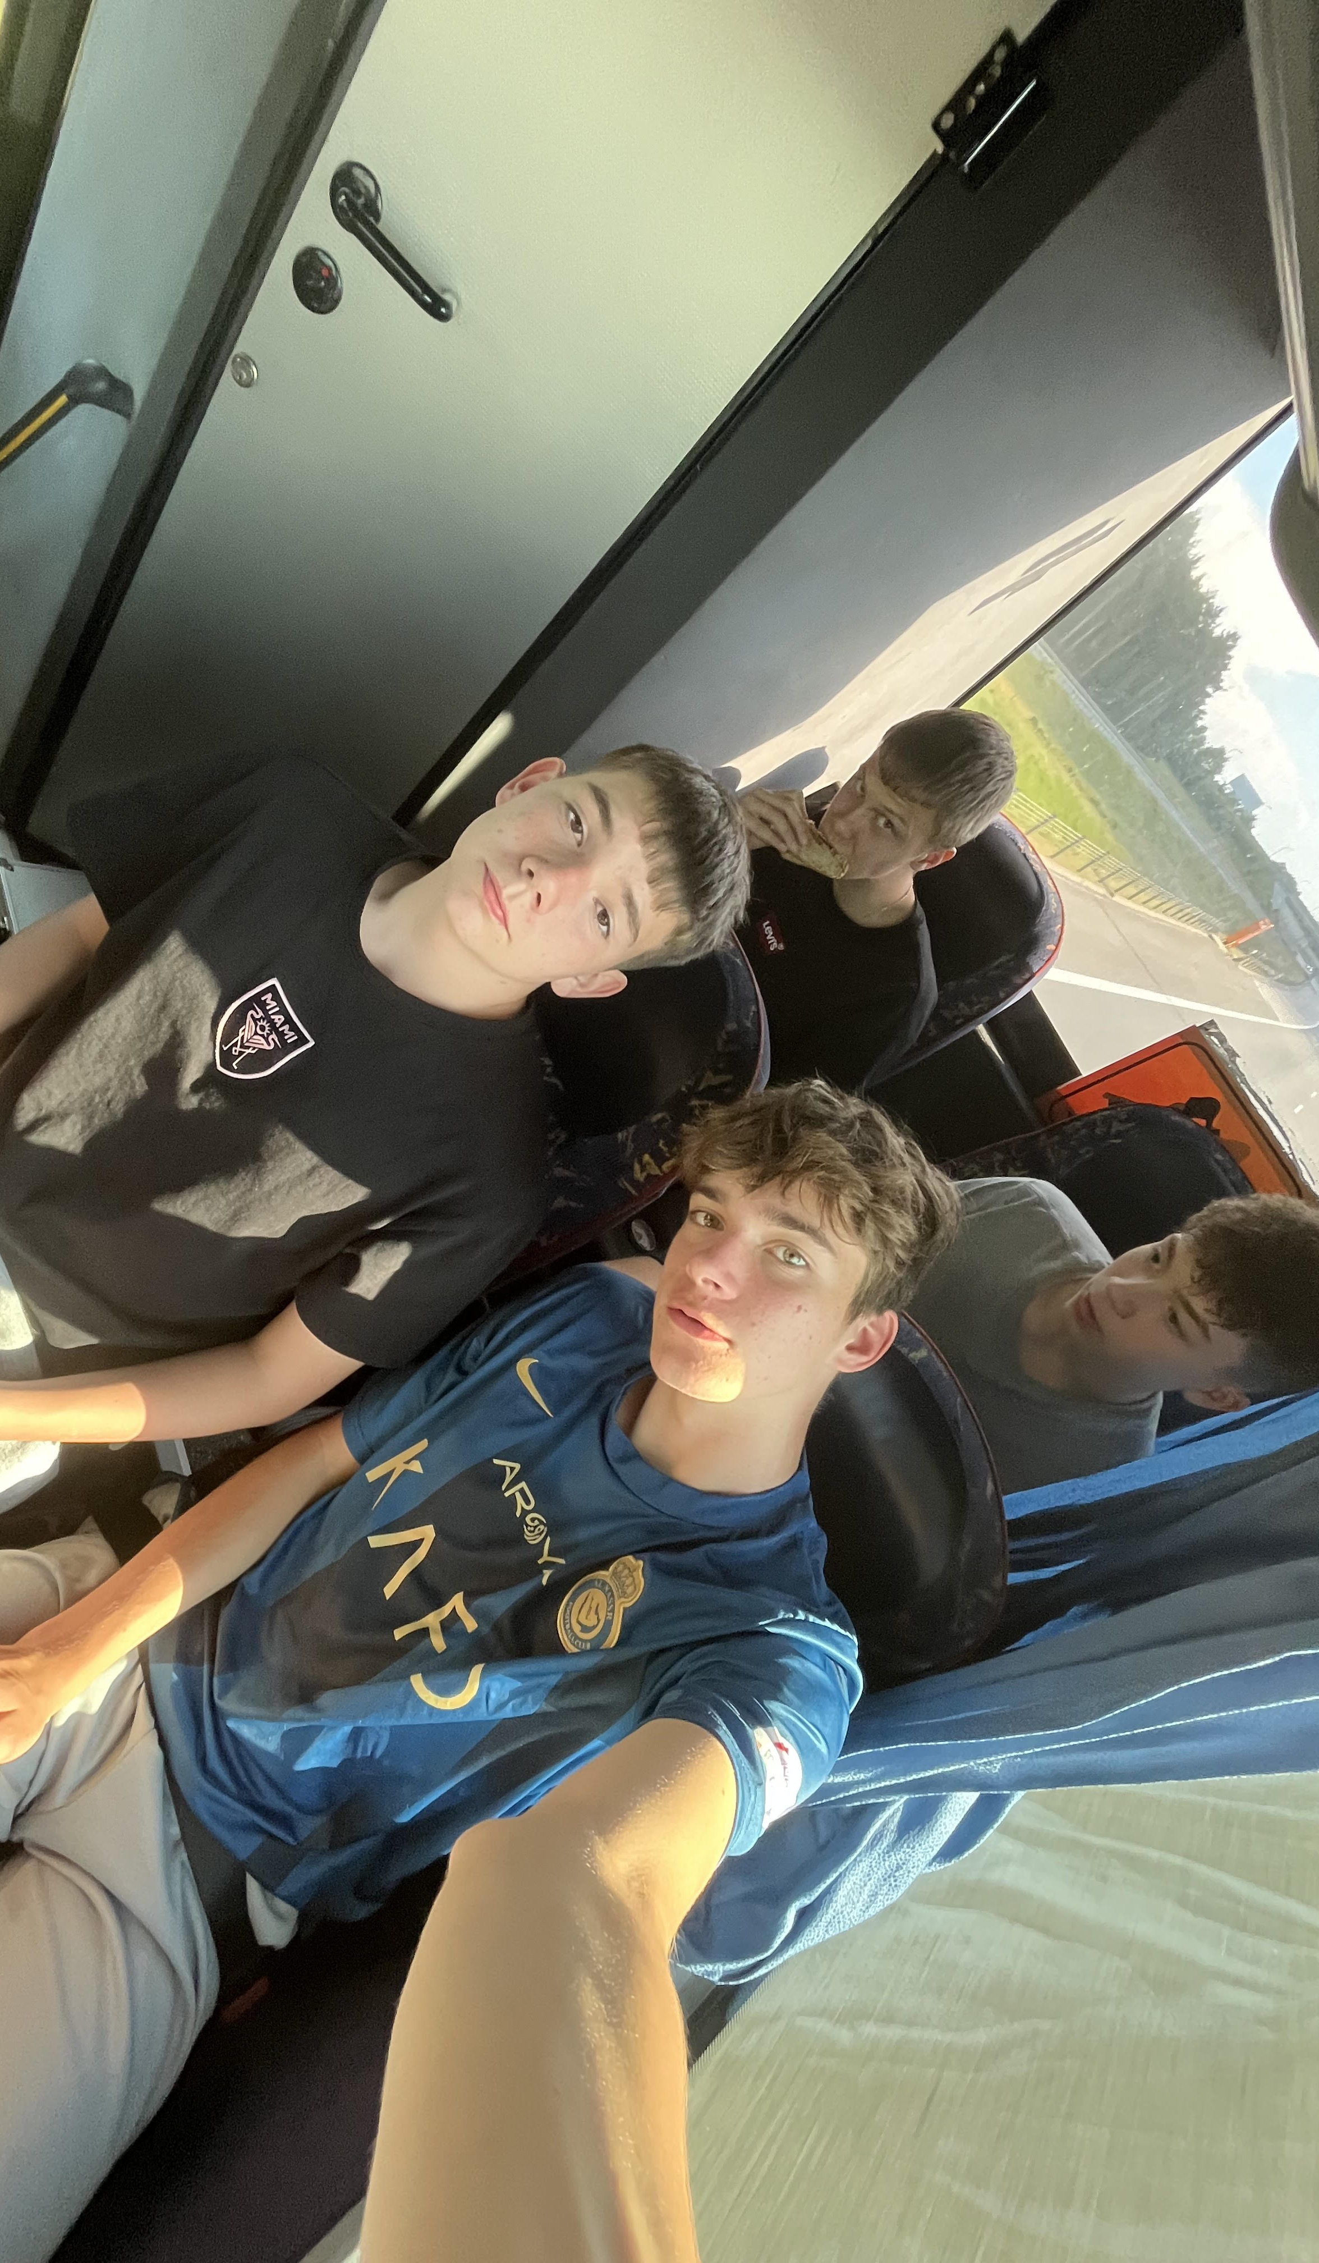
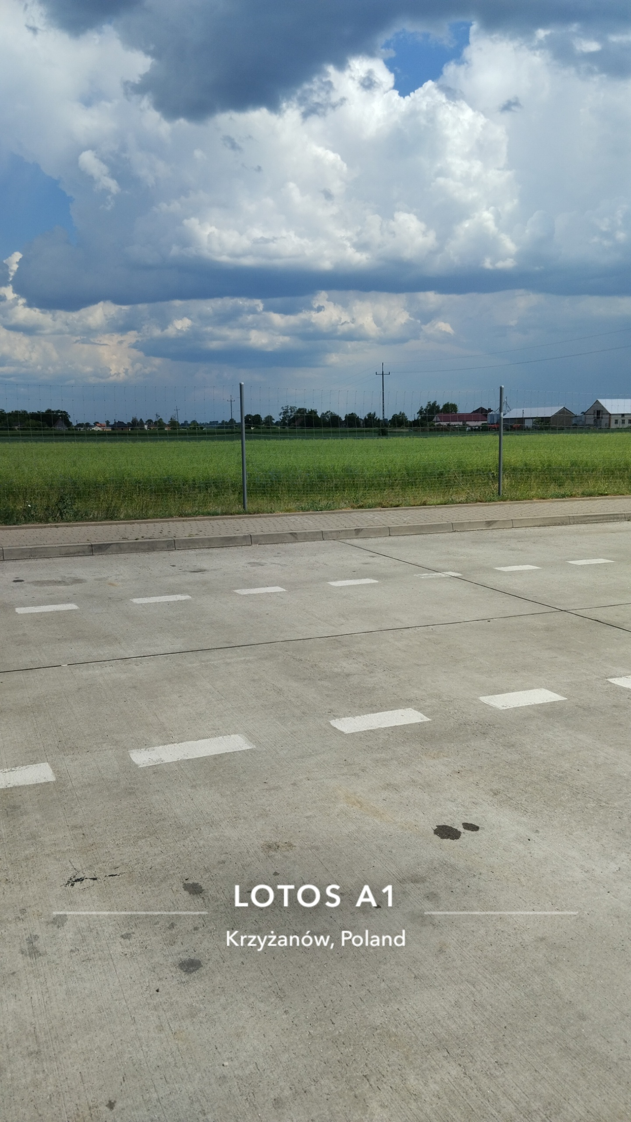
This is us.
This is the gas station where we had break for snacks.
This is our school.

Slide 4
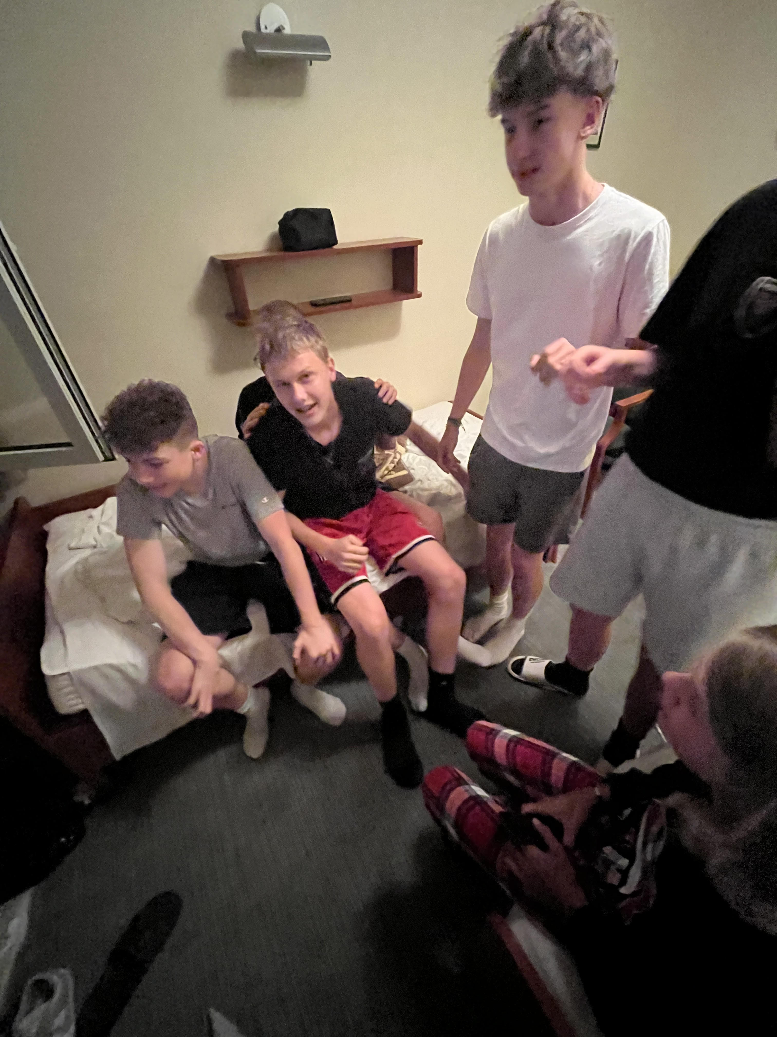
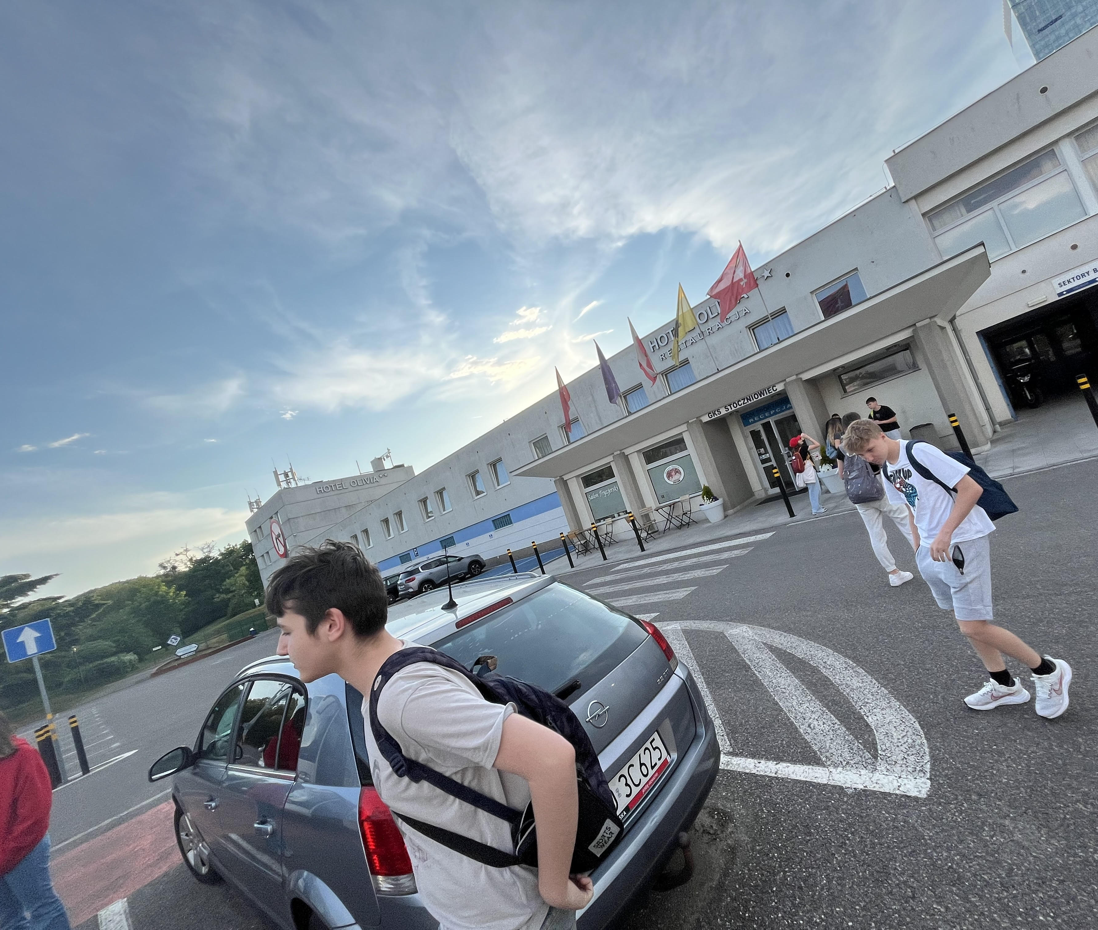
We are already in hotel and we watch hockey.
This is our hotel and we are packing out and we are
enjoying our trip till now.

