Slide 1

MALBORK
Zelinka , Kroužel , Horáček

Slide 2
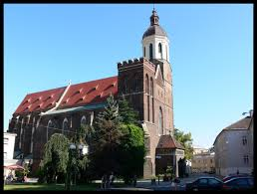
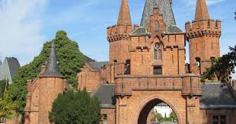
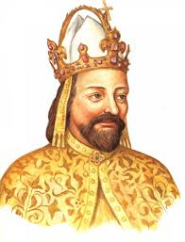
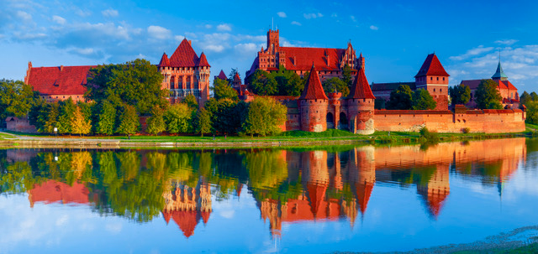

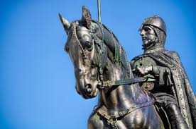
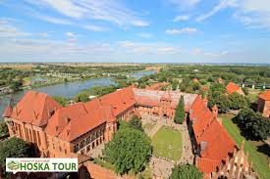
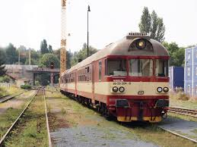
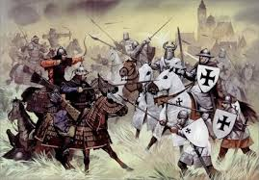
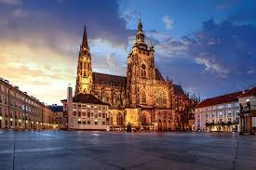
Brick castle in Opava
Visiting Charles IV.
Cathedral Ascension Virgin Mary, Opava
In Malbork St. Wenceslas on visit
The largest Gothic castle in the world
Malbork Castle consists of three parts -
Low, Medium and High castle
The owner of the castle was the Teutonic Knigths
There is a direct train connection from Ostrava to Gdynia
Malbork Castle is
a UNESCO monument as a castle in Prague
The construction of the castle began afther 1280

