Slide 1
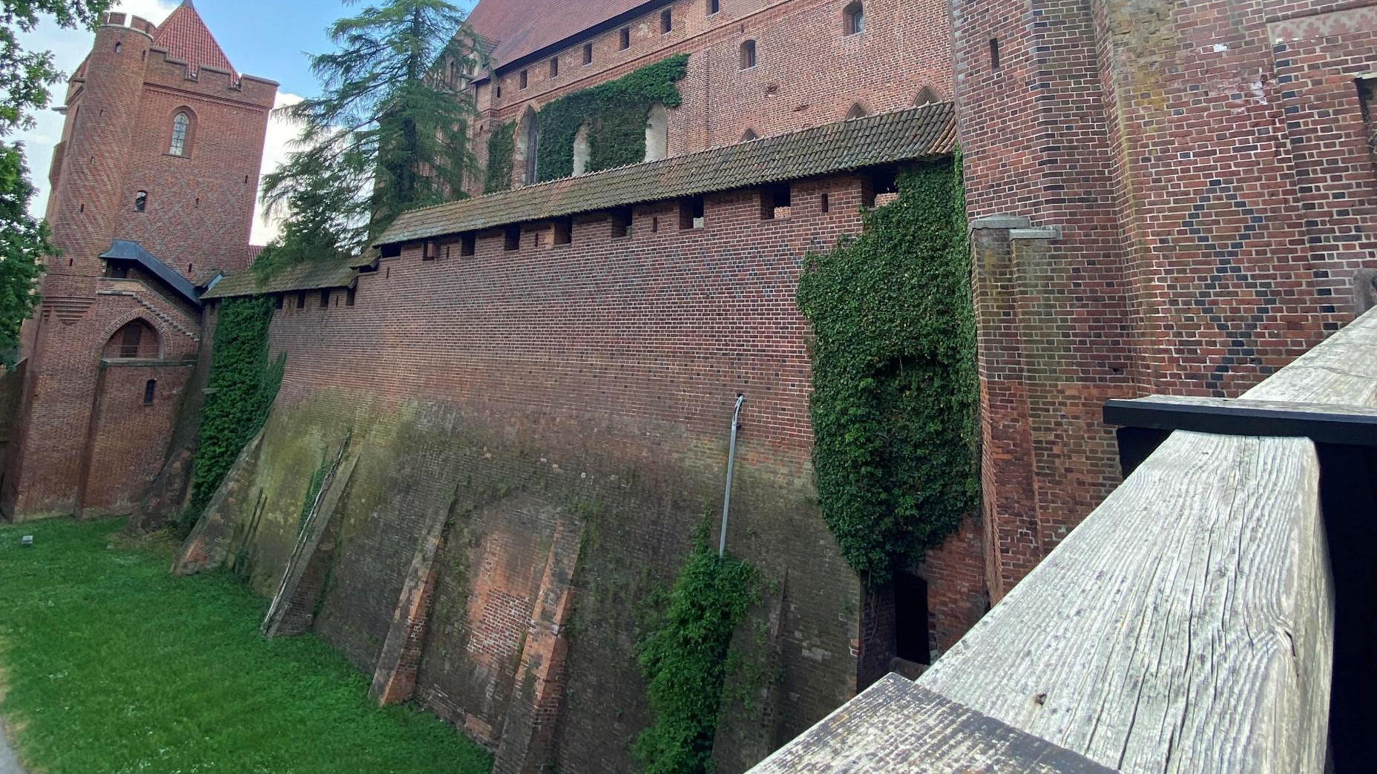
Day 5
By: Veselý, Folwarczny, Kwasnica, Mikunda

Slide 2
Day 5
We woke up at 7:00 then we got ready for breakfast that started at 7:30. After breakfast we went to our rooms and took a nap because we were leaving at 13:00. We were sleeping for 2 hours – we were very tired from previous trips and activities. After all boys from our class woke up, they came to our room where we were playing poker and listening to music. After listening to songs we noticed we have to get ready for lunch that started at 12:00. After lunch we went to Malbork castle. After we arrived we had 30 mins look at some souvenirs. We had Czech speaking guide who showed us all 3 sections of castle. Lots of expositions were closed due to public holiday in Poland. After the tour in castle we had free time. Some of us went to McDonalds and some just went to explore the castle. Suddenly a hail storm started with heavy rain and we had to run to the bus and it was very fun. We went back to the hotel and we had some free time and then we had dinner. The trip was very fun and tommorow we are returning to Czechia.

Slide 3

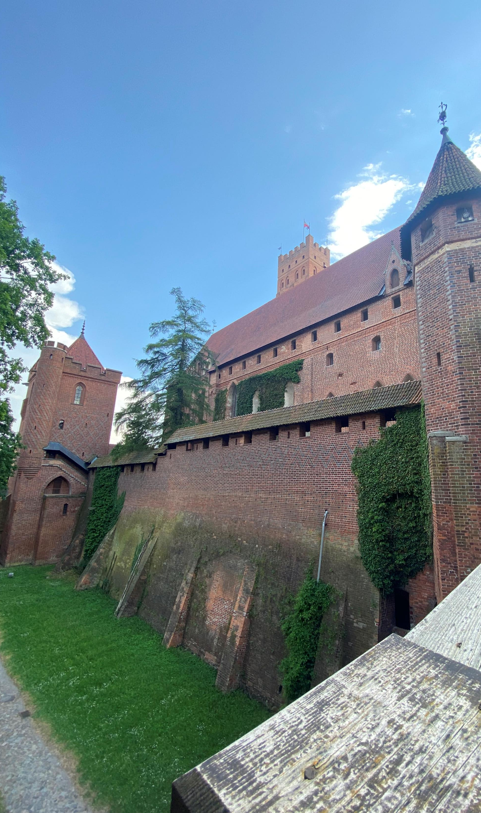
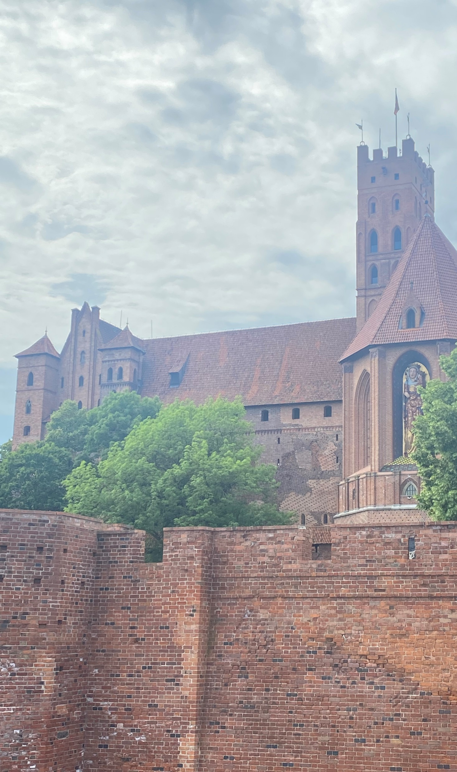
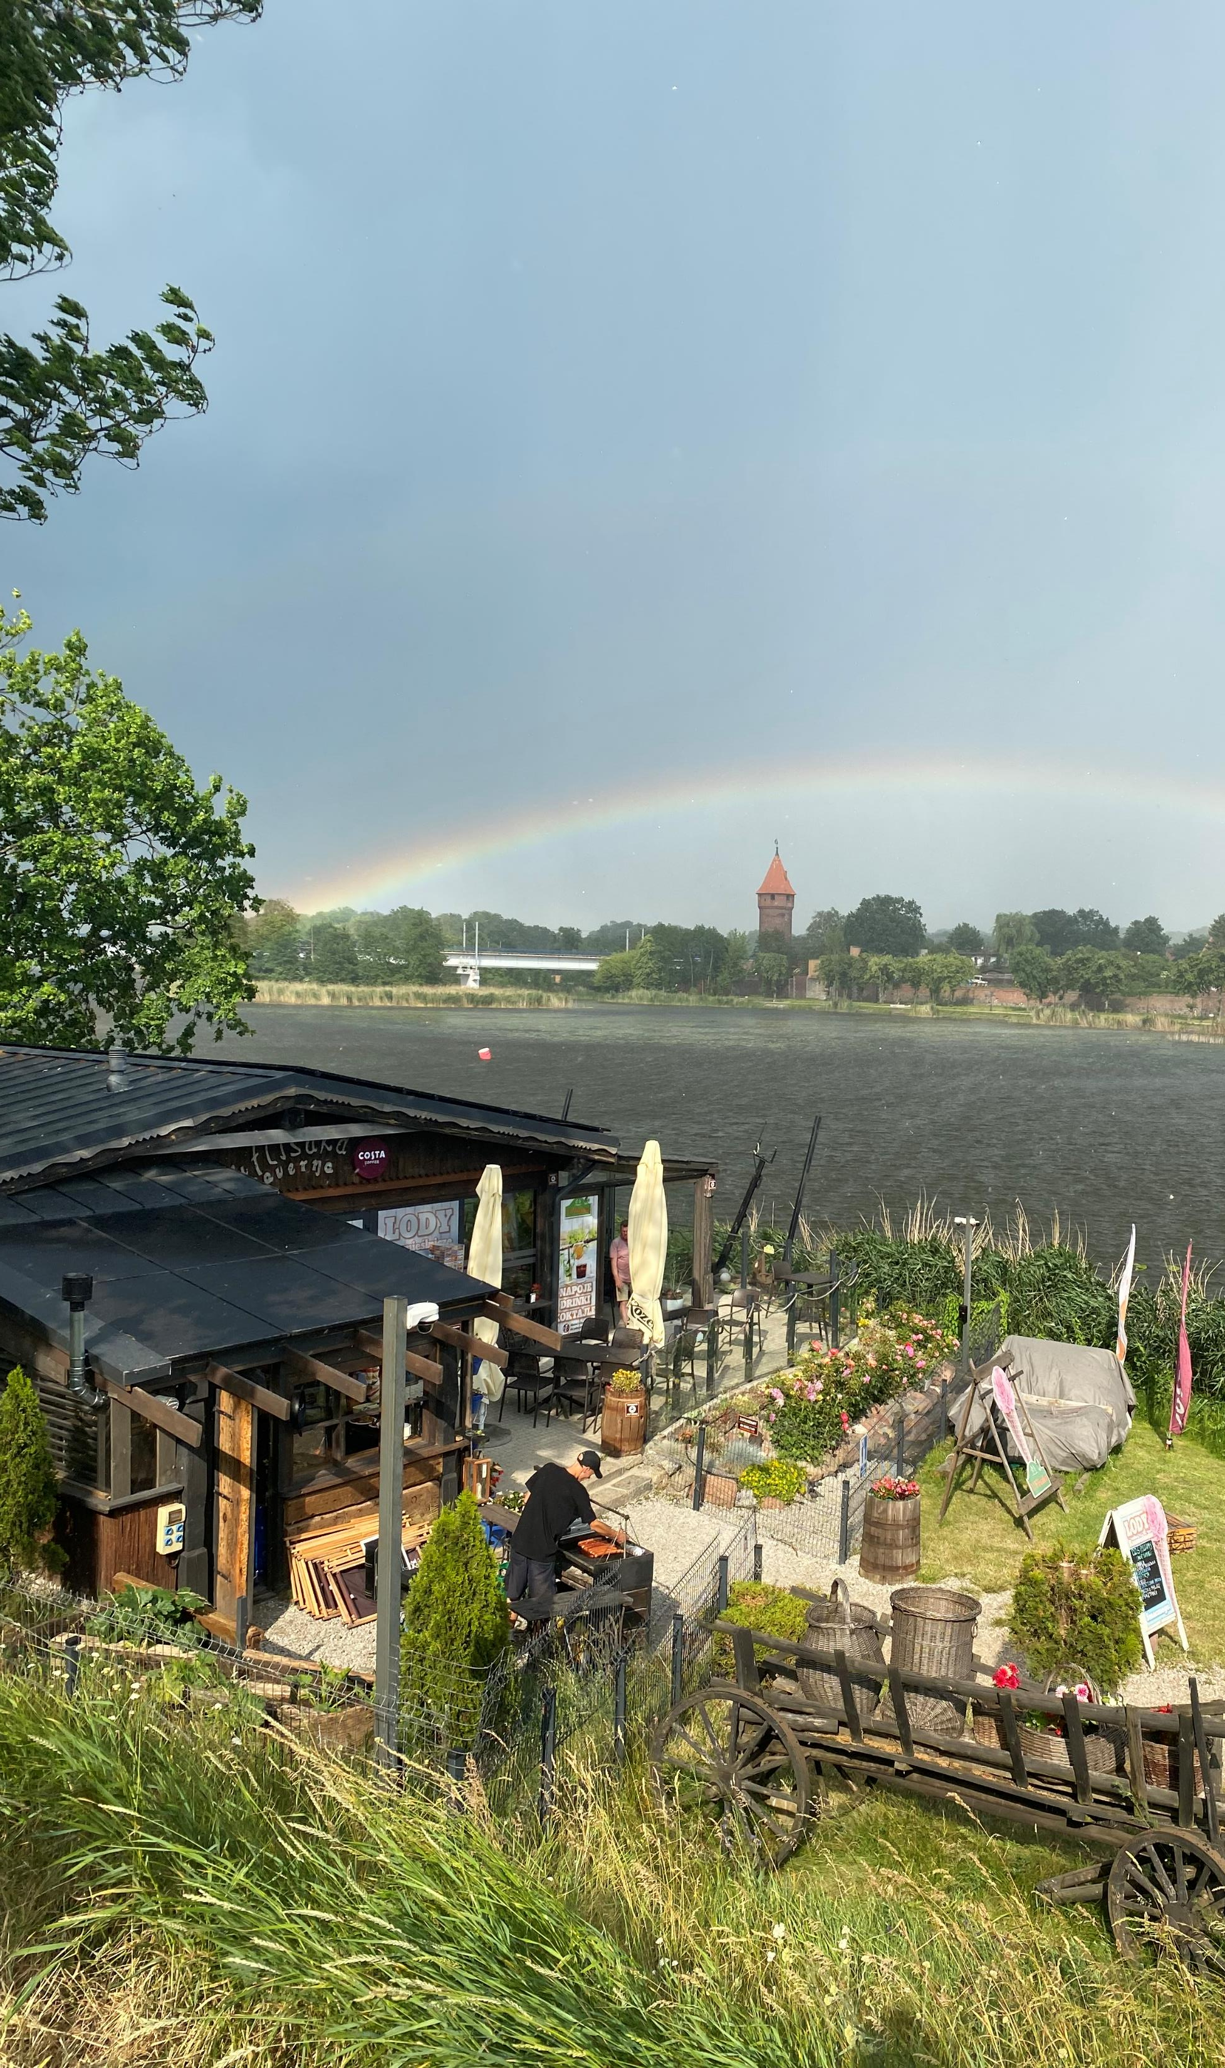
Rainbow next to castle
Malbork castle
Malbork castle

Slide 4
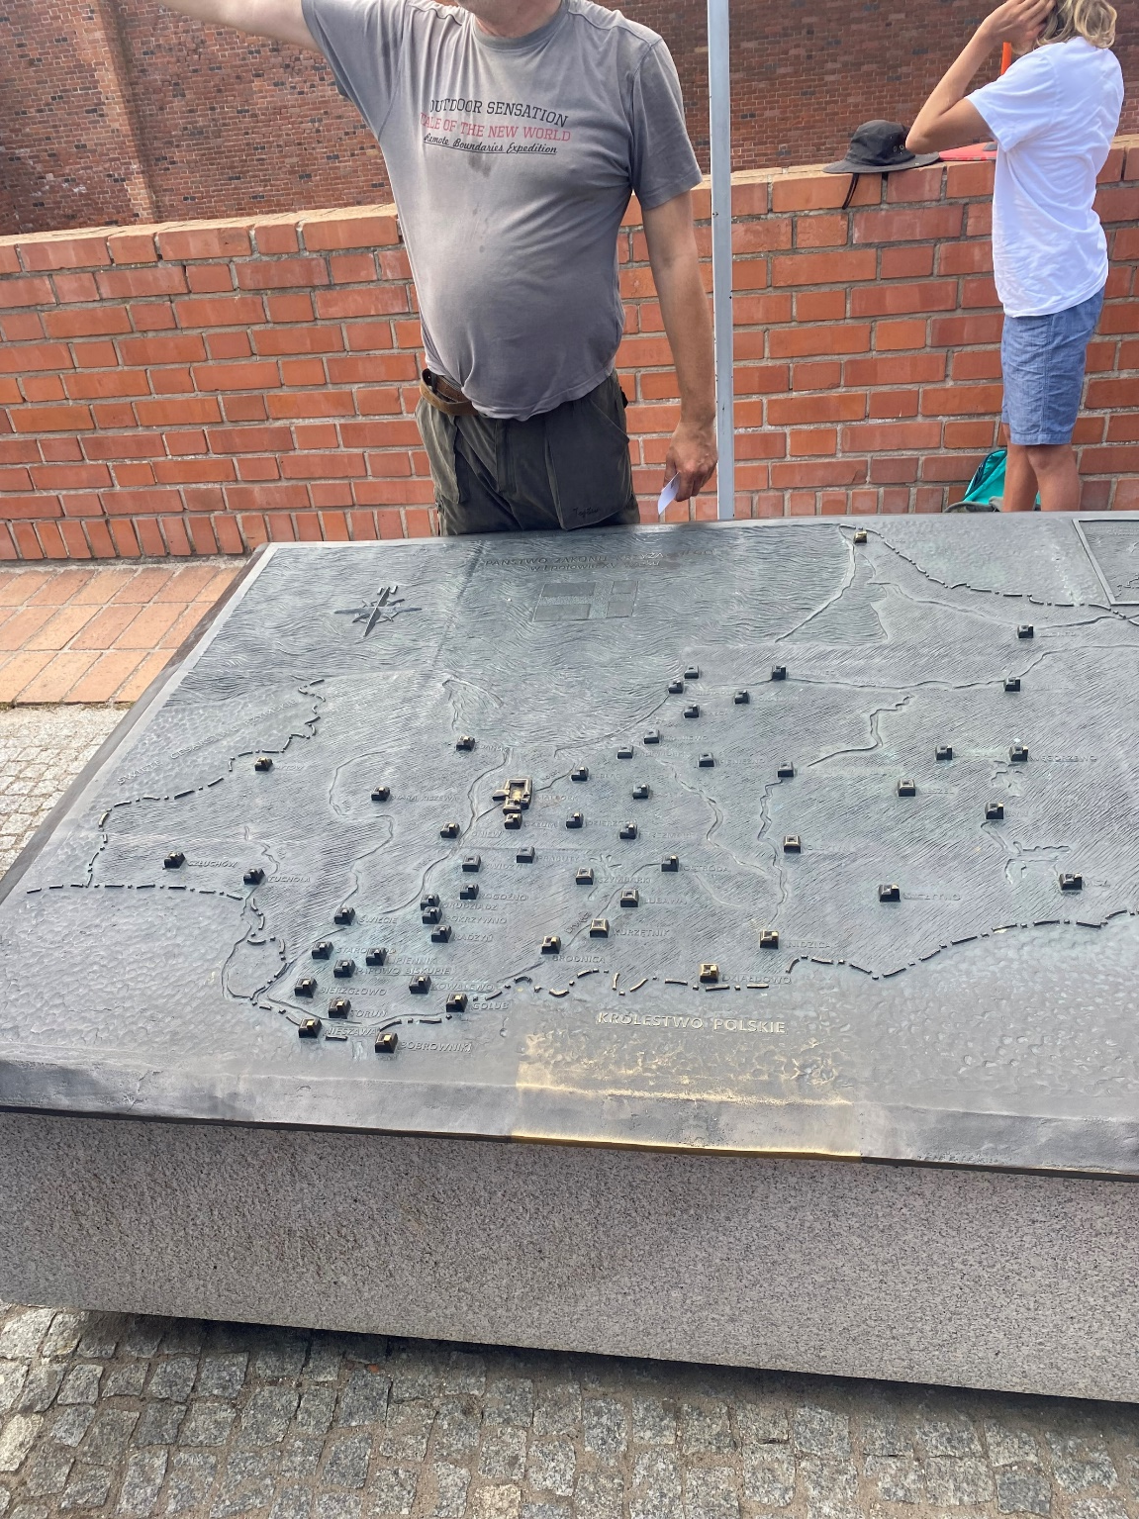
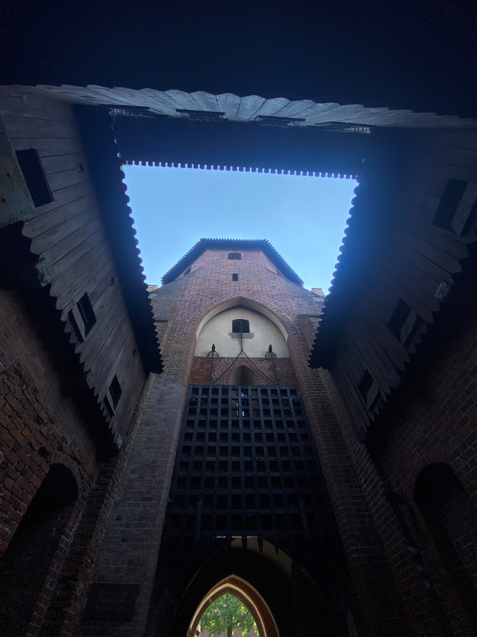
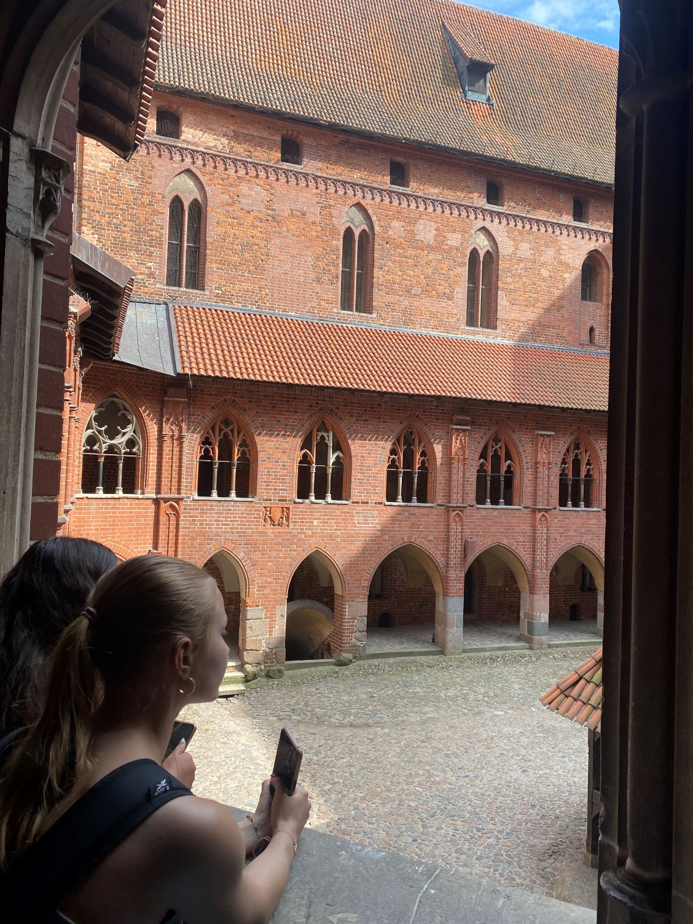
Minimap of whole Malbork

Slide 5
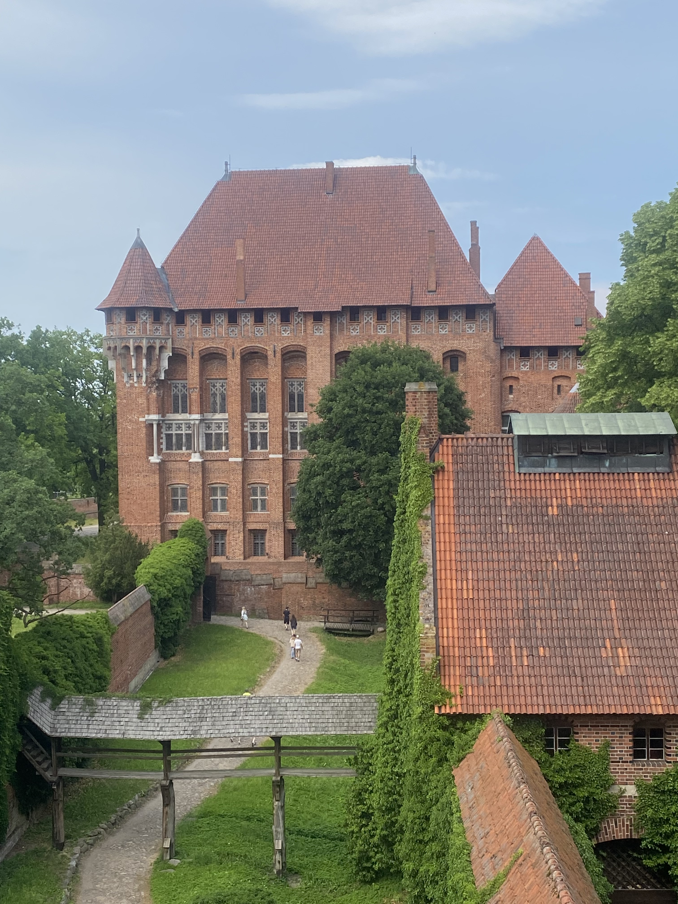
The end

