Slide 1
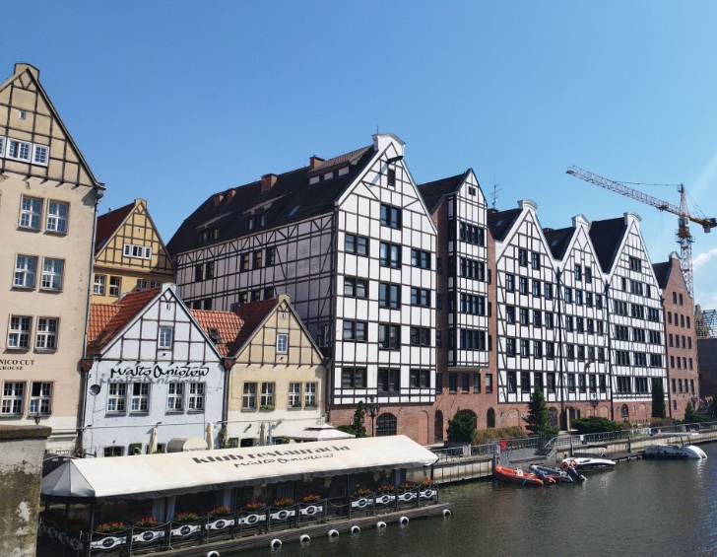
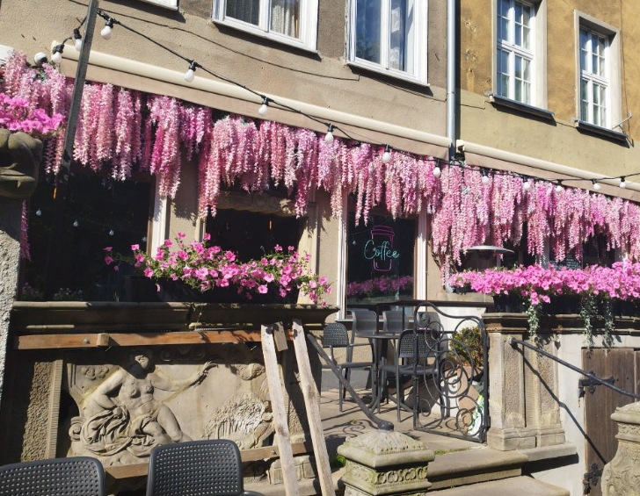
DAY 2
Vlhová, Chmielová, Brutti, Štěpánková

Slide 2
A Trip to school and exploring the city.
The first thing we did in the morning was going to breakfast and then getting ready to meet our polish friends in their school.
When we arrived to their school, they prepared some activity to get to know each other better. We also looked around the school. Their school is also sporting school, we could see a ballet training and gymnastic class. School design seemed very modern. We went to the centre of Gdansk, and we had a tour guide who talked about the history of Gdansk and showed us some monuments like Church, armour storage, etc.. We learned a little about the history of Gdansk, how it got independent and made its own laws and rules. We had also our free time to walk around, get some souvenirs or tasty food. This trip ended in the Gdansk centre‘s jail which was also interesting to see. Then we got the tram back to the hotel. For dinner we got a delicious grilled meat, which we all enjoyed. Our last trip was at night. Teachers took us for shopping to the mall. When we got back, we went to shower and went to sleep, and our day ended. We hope our next trips will be as nice as this one.

Slide 3
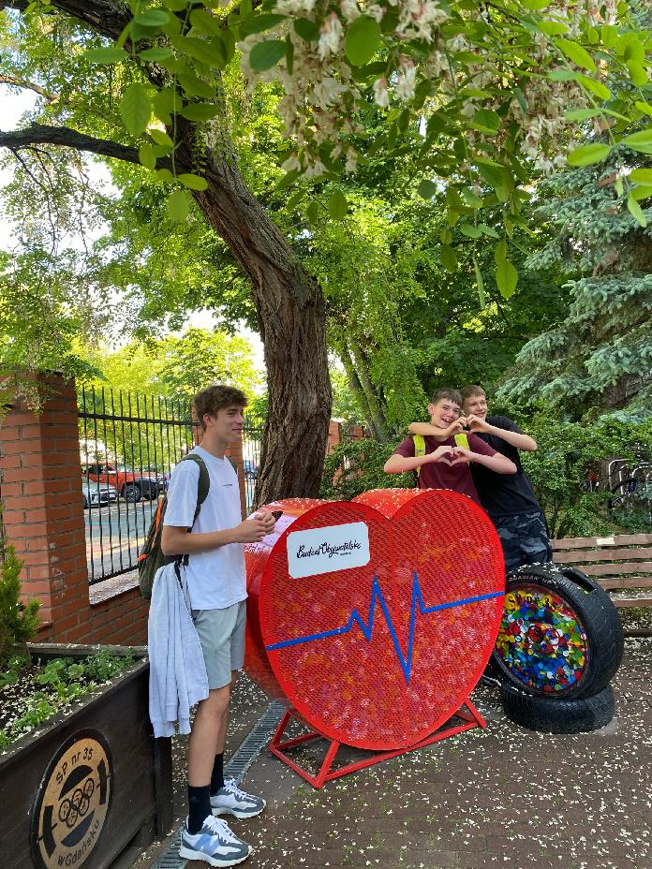
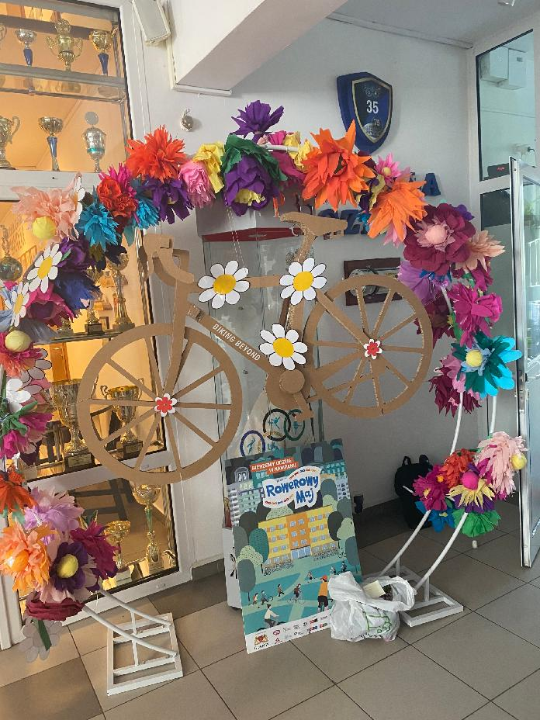
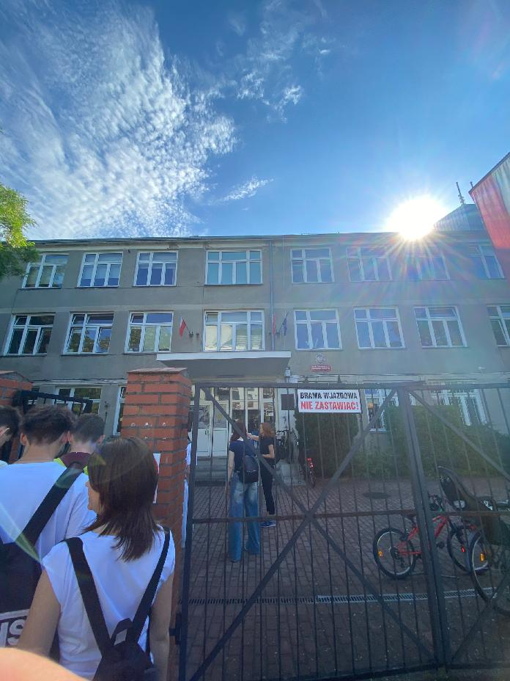
The School

Slide 4
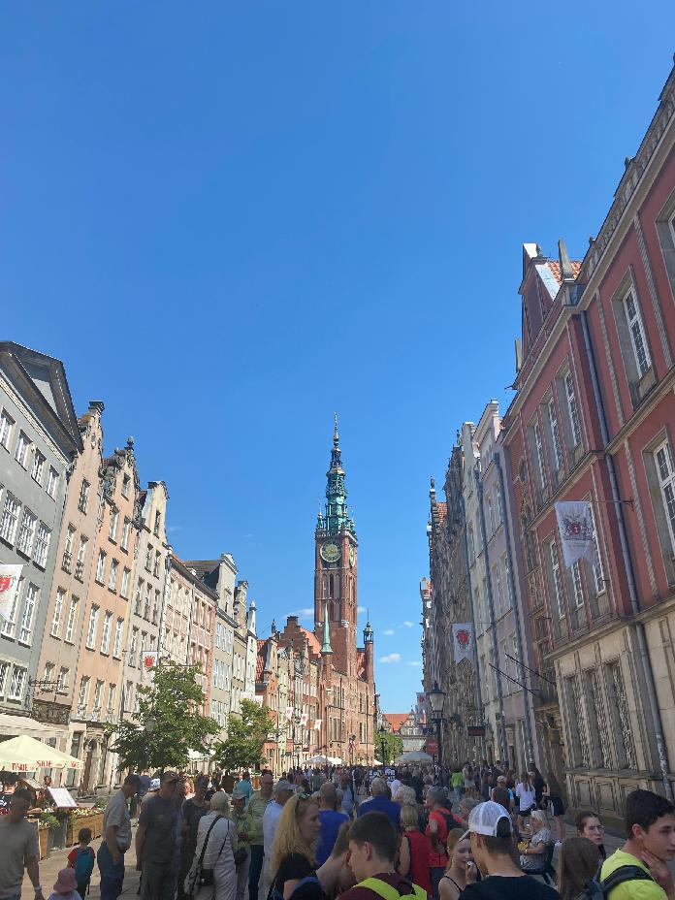
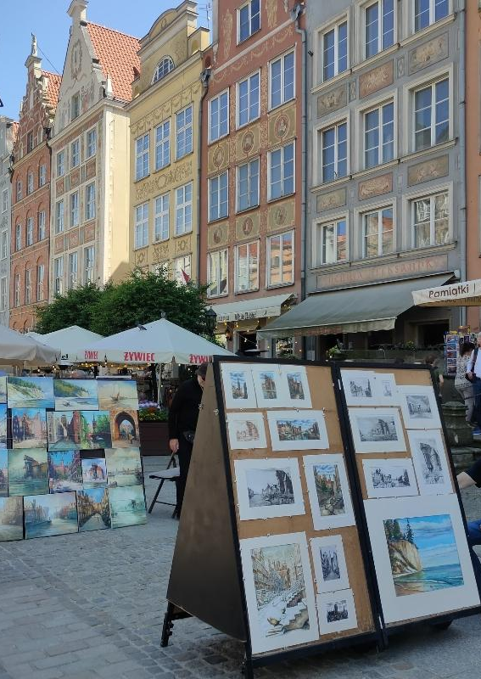
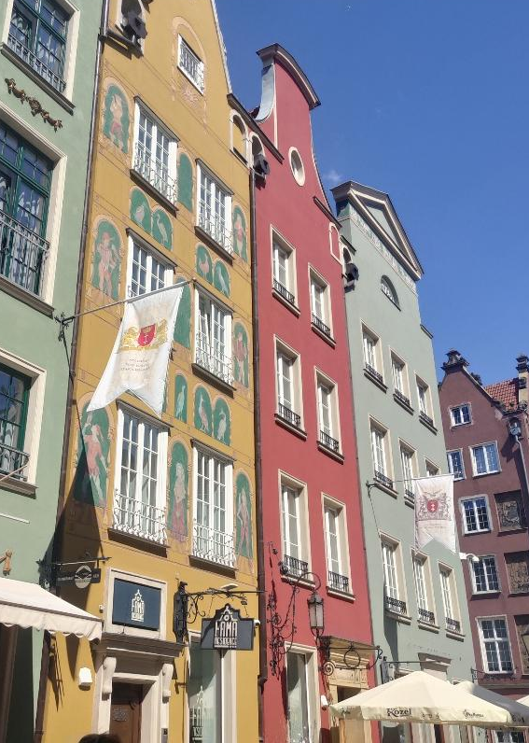
The City

Slide 5
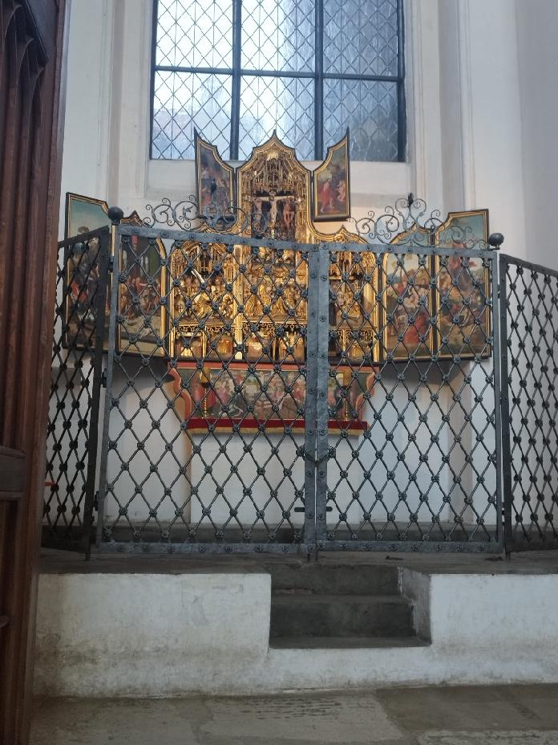
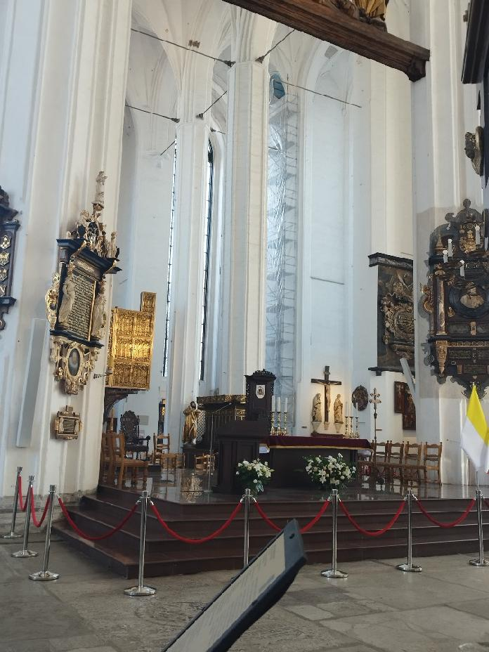
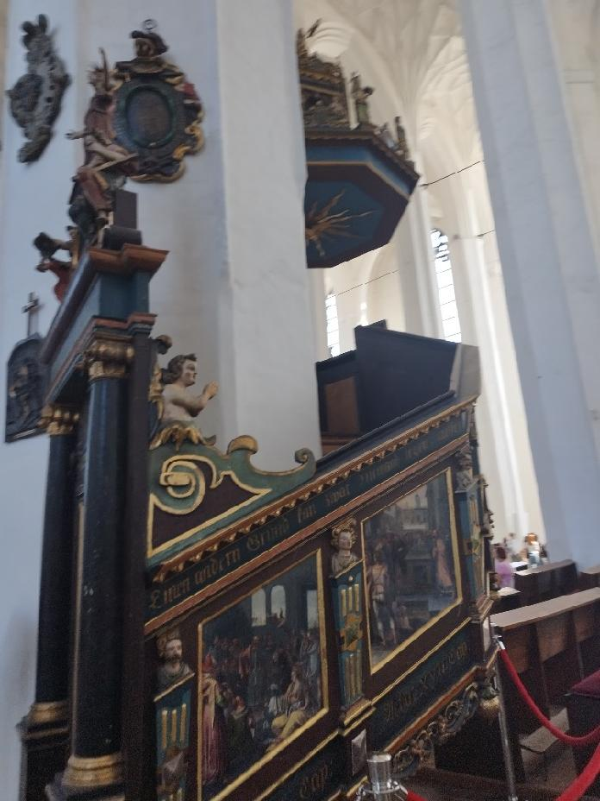
The Church

Slide 6
The end
Thank you for your time

